Slide 1
Australians in WW1
Into the unknown.

Slide 2
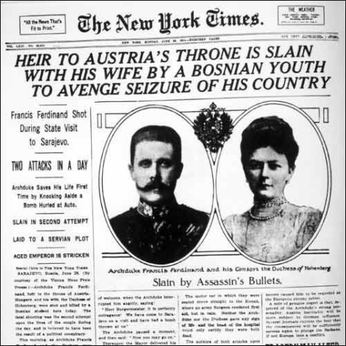
In June 1914 a Bosnian Serb assassinated Archduke Franz Ferdinand, the heir to the Austro-Hungarian throne.
As a result, Austria declared war on Serbia.
Russia, which had an alliance with France, supported Serbia, while Germany sided with Austria and invaded neutral Belgium to enter France.

Slide 3
In response to the invasion of Belgium, whose neutrality it had guaranteed, Britain declared war on Germany on the 4th of August 1914.
Australia remained staunchly loyal to the British empire and so declared its full support for the war effort.

Slide 4
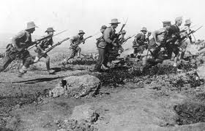
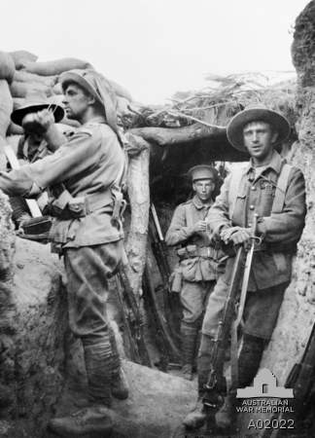
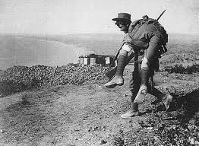
Although the theatres of war were very distant from Australia, its membership of the British Empire ensured that there was strong (although not universal) public support for involvement in the war.
In 1914, Australia's Prime Minister, Andrew Fisher, immediately promised Australian support for Britain 'to the last man and the last shilling'.

Slide 5
The Australian population in 1914 was less than five million.
involved:
- Enlisted and served overseas: 324,000 - Dead: 61,720 - Wounded: 155,000 (all services) - Prisoners of war: 4,044 (397 died while captive) (Source: Australian War Memorial at http://www.awm.gov.au/)

Slide 6
Britain’s declaration of war was met with great enthusiasm and thousands of volunteers, keen for adventure, rushed to join up. One volunteer was a 24-year-old farmer by the name of Archie Barwick –
“To my great joy and no less surprise, I was requested to report at once to Victoria Barracks in Sydney for medical inspection. I think I threw two or three somersaults."

Slide 7
Most young men were proud to support the Empire and looked forward to the glory of battle, and many expected it all to be over quite swiftly.
In addition, troops were paid six shillings a day, which was attractive in those tough financial times.
And so, the Australian Imperial Force was formed in 1914.
New Zealand showed similar enthusiasm and formed an Expeditionary Force.

Slide 8
On the 1st of November 1914 the first troop convoy of Australians and New Zealanders set off from Albany, Western Australia, destined for the war in Europe.
“We lifted our anchors and the great fleet set sail. The Australian ships led the way and the New Zealanders brought up the rear.” - Archie Barwick

Slide 9
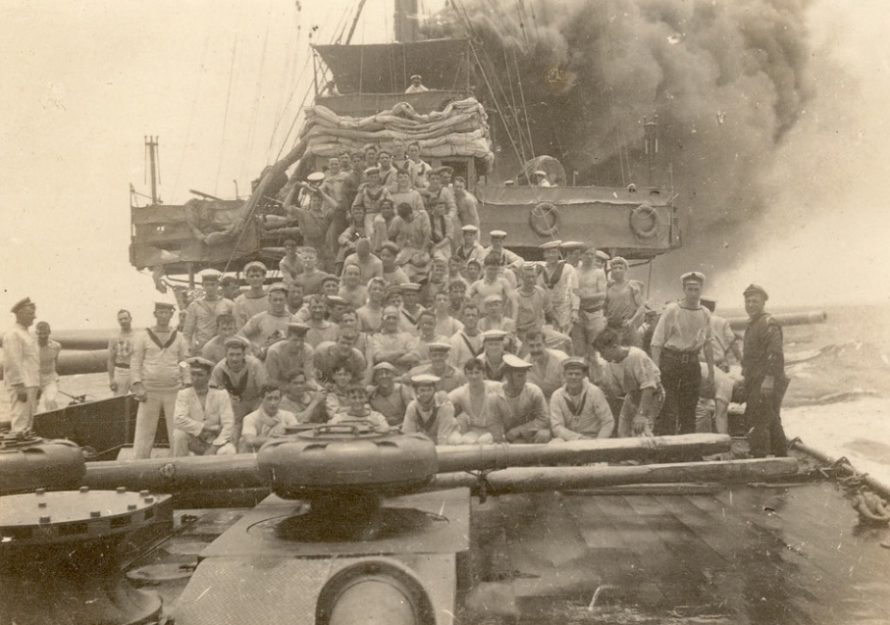
En route the convoy received an SOS signal from a communication station in the Cocos–Keeling Islands that had been raided by the German light cruiser Emden.
HMAS Sydney was ordered to investigate, and soon found itself in a deadly fight after Emden opened fire on it, inflicting serious damage. Sydney fired back, finally destroying the Emden and rescuing the survivors.

Slide 10
“All of a sudden I heard a terrible noise on deck. I hopped up & there was a notice pinned on the wall to the effect that the Sydney had destroyed the Emden. The boys were delighted, seeing as how it was our boat that done the trick.” – Archie Barwick
News had now been received that, instead of heading for Europe, the men were bound for Egypt, where they would complete their training.

Slide 11
Questions
What date did Britain declare War on Germany?
Who was Australia’s Prime Minister in 1914?
What was Australia’s population in 1914?
What was the reaction in Australia to Britain’s declaration of war?
Why do you think Australians reacted the way they did to the declaration of war? Provide 3 reasons
When did Australian troops first set off to join the war?
Use the following links to research the history of SMS Emden: http://www.awm.gov.au/units/unit_12749.asp
http://www.awm.gov.au/blog/2013/10/01/education-memorial-finding-elusive-count-von-spee
Why would HMAS Sydney have helped wounded sailors from the Emden and kept them on board?
The sinking of the Emden was commemorated in Australia with souvenirs including jugs, cups, and saucers (see image below). Why would these have been made and bought? What does this suggest about Australia’s attitude to war?

Slide 12
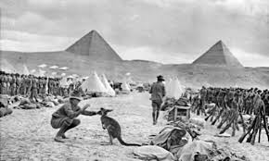
Egypt

Slide 13
Disembarking in Cairo, they set up a large tented camp, where two new divisions – the 1st Australian Division and a composite New Zealand and Australian Division – were formed into a new body, the Australian and New Zealand Army Corps.
The name was quickly shortened to ANZAC.

Slide 14
Accompanying the men was a journalist named Charles Bean, who had been appointed as Australia’s official war correspondent. Here he set down his first thoughts on the all-volunteer Australian Imperial Force –
“They’re not heroes. They do not intend to be thought or spoken of as heroes. They’re just ordinary Australians, doing their particular work as their country would wish them to do it. And pray God, Australians in days to come will be worthy of them.”

Slide 15
Training in Egypt was based on earlier wars, with rifles, bayonets and bugles, and the men were largely inexperienced.
They were far from the main European theatres of war ... but within months, their situation would change dramatically.
The British War Cabinet was looking for ways to help break the stalemate on the Western Front.
Their idea was for a naval attack upon Turkey, which had entered the war on Germany’s side.

Slide 16
After several unsuccessful attempts to force a passage through the straits of the Dardanelles, it was decided that a landing should be made on the Gallipoli peninsula.
And so, British, French, Indian, Australian and New Zealand troops totalling some 70,000 men were assembled and shipped out to Gallipoli.

Slide 17
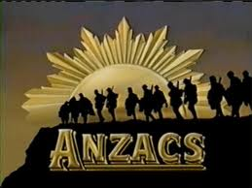
The Anzacs
The name became famous with the landing of the Corps on the Gallipoli Peninsula, Turkey on 25 April 1915. It was the first military engagement in which significant numbers of Australians fought and died as Australian nationals.
The Anzacs were part of an Allied campaign against the Turks to control the Dardenalles and thus open the way to Constantinople and Eastern Europe.

Slide 18
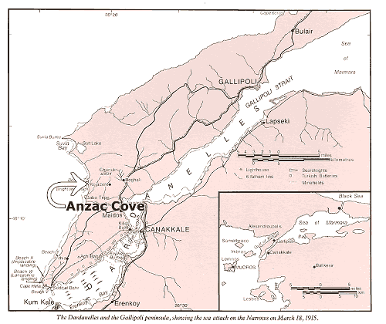
This engagement ended with the evacuation of Australian troops on 19 - 20 December 1915.

Slide 19
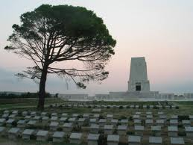
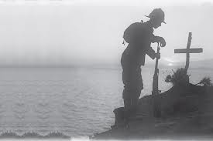
The Gallipoli campaign resulted in the deaths of:
7,600 Australians and
2,500 New Zealanders
and the wounding of:
19,000 Australians and
5,000 New Zealanders.

Slide 20
Location of Australian forces
First Australian troops sent to Egypt to defend British interests against the Ottoman Empire (Turkey), 1915
Engaged in battle on the Gallipoli Peninsula against the Turks on 25 April 1915
Evacuated from Gallipoli 19 - 20 December 1915
The Australian Imperial Forces (AIF) then reorganised; expanded from two to five infantry divisions
Transferred to France from March 1916
AIF mounted division remained in the Middle East

Slide 21
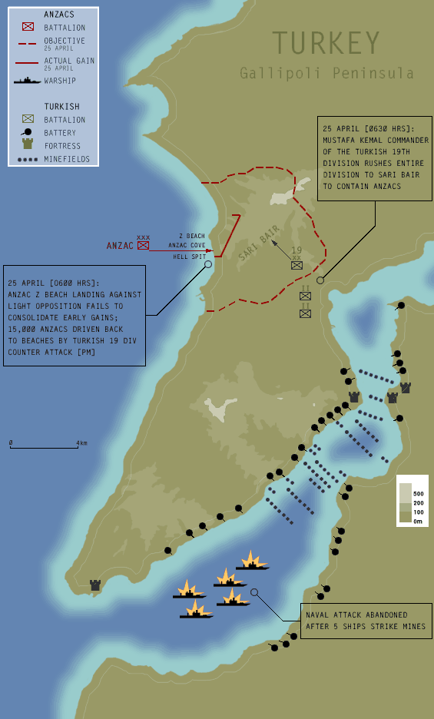

Slide 22
http://www.abc.net.au/innovation/gallipoli/gallipoli2.htm#

