Slide 1
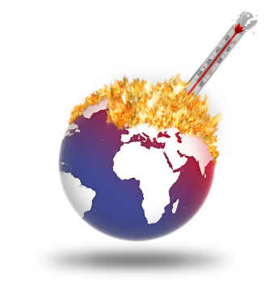
Global Warming

Slide 2
What Is Global Warming?
Global warming is when the earth heats up and the temperature increases
More recently, the temperatures have been rising, causing more dangers for people, animals, plants and our environment.

Slide 3
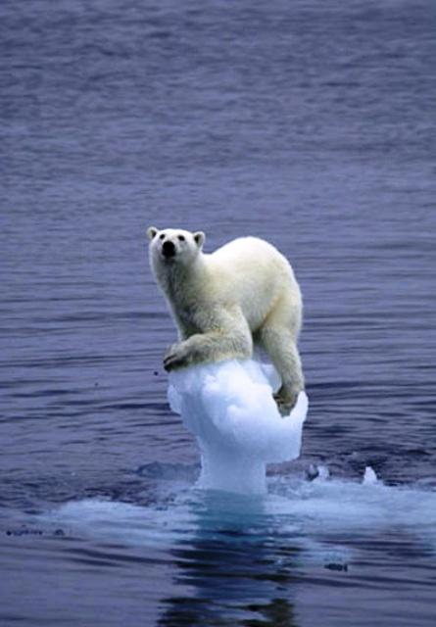

Slide 4
The Greenhouse Effect
The greenhouse effect is when the temperature goes up, on Earth, since the sun’s heat and light energy is trapped in the earth’s atmosphere.
While the heat from the sun enters our atmosphere, the heat has trouble leaving back out our atmosphere

Slide 5
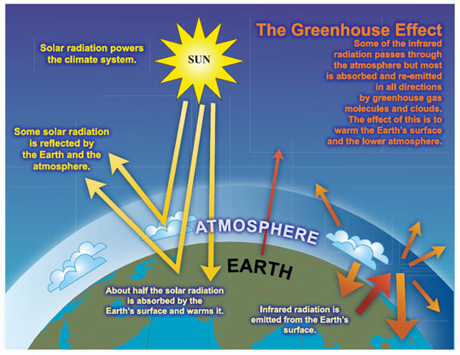

Slide 6
Causes of Global Warming
Electrical pollution is a main cause for Global Warming. Mostly, fossil fuels are burned to create electricity and are made of dead plants and animals. Some examples of fossil fuels are oil and petroleum. Many pollutants (chemicals that pollute the air, water, and land) are sent into the air when fossil fuels are burned. Some of these chemicals are called greenhouse gasses.
Petroleum, one of the sources of energy, is used a lot. It is used for transportation, making electricity, and making many other things. Although this source of energy gives off a lot of pollution, it is used for 38% of the United States’ energy.
When we throw our garbage away, the garbage goes to landfills. They are full of garbage. The garbage is then sometimes burned. This sends an enormous amount of greenhouse gasses into the air and makes global warming even worse.
Another factor that makes global warming worse is when trees are cut down. Trees and other plants collect and absorb carbon dioxide (CO2), which is a greenhouse gas.

Slide 7
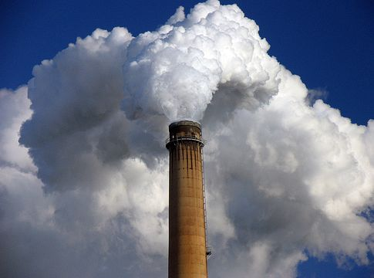

Slide 8
Results of Global Warming
Global warming is affecting many parts of the world, including melting glaciers, creating the sea to rise even more, and when that happens, the water covers many low land islands.
Global Warming also destroys many huge forests. The pollution that causes global warming is linked to acid rain. Acid rain gradually destroys almost everything it touches. Global warming is also causing many more fires that wipe out whole forests. This happens because global warming can make the earth very hot. In forests, some plants and trees leaves can be so dry that can catch on fire.

Slide 9
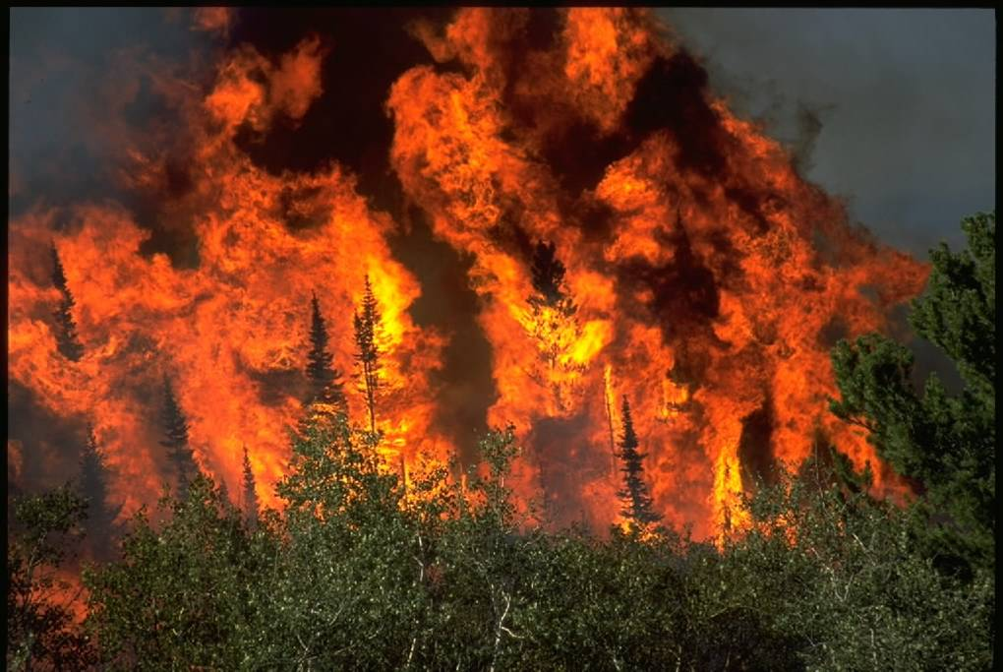

Slide 10
