Slide 1
Ancient Egyptian Gods

Slide 2
In ancient Egyptian times, gods were extremely important
in making the country run properly so the Egyptians
worshipped gods for just about everything- flooding, health, love, having babies, the sun, the sky and so on.
There were over 2000 gods- that’s a lot more than all of the gods in all of the different religions that exist nowadays! The gods were male, or female (goddesses) and were often shown as having the body of a human and the head of an animal or bird.
Can you imagine trying to remember 2000 names and their job?!

Slide 3
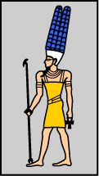
Amun Was one of the most important gods in ancient Egyptian history. He was know as the ‘King of the Gods’
Amun was depicted in two different ways, in one, he had the head of a ram, in the other, he had a headdress made of ostrich feathers.
At some point during the Egyptian times, Amun became even more powerful when he combined with the sun god, Ra. He then became Amun-Ra.
Amun has a temple which was built to honor him in Thebes.

Slide 4
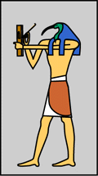
Thoth
A man with the head of an ibis holding a writing palette
Thoth was the god of writing and knowledge.
The ancient Egyptians believed that Thoth gave them the gift of hieroglyphic writing. Thoth was also connected with the moon.

Slide 5
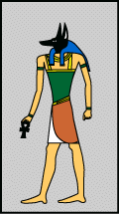
Anubis Was the god of embalming (wrapping dead bodies in linin) and the dead.
Anubis was depicted in with a jackal head. The ancient Egyptians believed that Anubis watched over the dead because jackals were often seen in cemeteries.
Anubis watched over all of the mummification that took place in ancient Egyptian times. He helped to embalm Osiris after he was killed by Seth.
Priests often wore a mask of Anubis during the embalming process.

Slide 6
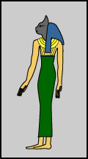
Bastet Was a protective goddess.
Bastet, also known as Bast, had the head of a cat. However, at times of battle, she was depicted with a lioness’ head to protect the King, or pharaoh.
Bastet was usually a gentle goddess, and many ancient Egyptians had statues of cats to protect them. She was the daughter of Ra, the sun god.
A great temple was built in her honour at Bubastis in the Delta.

Slide 7
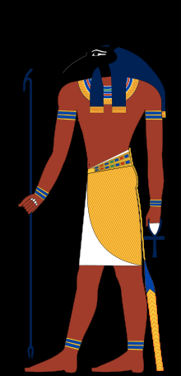
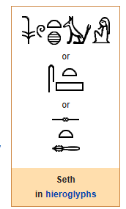
Seth
God of storms, desert, chaos and war
Seth was represented as a composite figure, with a canine body, slanting eyes, square-tipped ears, tufted (in later representations, forked) tail, and a long, curved, pointed snout

Slide 8
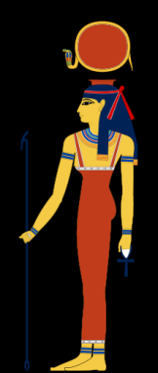
Hathor
personified the principles of joy, feminine love, and motherhood
The goddess Hathor wearing her headdress, a sun disk with uraeus set between the cow-horns
Goddess of the sky, love, beauty, joy, motherhood, foreign lands, mining, music and fertility

Slide 9
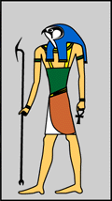
Horus Was the god of the sky.
Horus had the head of a hawk and was believed to be living within the pharaohs.
He was the main protector of the king or queen of ancient Egypt.
Horus was believed to be the son of Isis and Orisis. He was believed to have lost one of his eyes whilst battling against Seth for the throne.
One of the best-preserved temples in Egypt today was dedicated to Horus. It is located in Upper Egypt at a town called Edfu

Slide 10
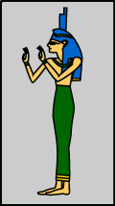
Isis Was a protective goddess who used spells to protect.
Isis was depicted in two ways, having a throne shaped headdress, and having cows horns with a sun between them. She used powerful magic spells to help people in need.
Isis was the wife of Osiris and the mother of Horus. Since each pharaoh was considered the 'living Horus', Isis was very important. Isis is associated with thrones because her lap was the first 'throne' that Horus sat upon.
A temple was built to honour Isis at Philae. It is still standing today.

Slide 11
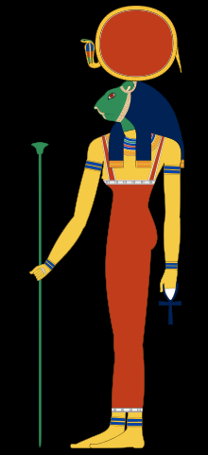
Sekhmet
Goddess of fire, war, vengeance, menstruation, and medicine
Sekhmet with head of lioness and a solar disk and uraeus on her head

Slide 12
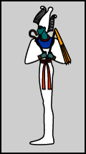
Osiris Was the god of the dead and ruler of the underworld.
Osiris was shown to be a human who was mummified and wore a cone-like headdress with feathers. Osiris was also the god of resurrection and fertility.
The ancient Egyptians believed that Osiris gave them the gift of barley, one of their most important crops. Orisis was the husband of Isis, the protective goddess.
A large temple was built to honour Osiris at Abydos.

Slide 13
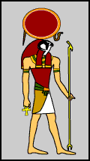
Ra Was the sun god, and the most important of the ancient Egyptians.
Ra had the head of a hawk and wore a headdress which was formed of a ring of sun. Ra was believed to be swallowed up by the sky goddess, Nut each night and reborn each morning.
The ancient Egyptians also believed that he travelled through the underworld at night. In the underworld, Ra appeared as a man with the head of a ram.
There are a number of temples in Thebes and Luxor which
are dedicated to Amun Ra, but none just for Ra.

Slide 14
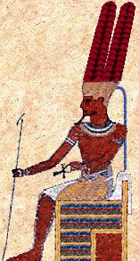
Amun Ra
He is the ultimate god of entire ancient Egypt; many of the Egyptians considered him as the God of Kings and King of Gods! He is the oldest and the most worshipped ruler of ancient Egypt.
A bearded Man wearing a cap surmounted by two tall plumes. A ram, a ram headed man, or a ram headed sphinx.

