Slide 1
Growing Up

Slide 2
There are a number of factors that help us understand the process of growing up.
Firstly, there are theories that outline how we develop our thinking skills (cognitive), moral decision making, emotional strength, and our needs in interacting with others (social development).

Slide 3
Secondly, a large component in our growing up and identity development occurs during a period of time called adolescence.
However, this period of time is uniquely a western cultural ideal and many of the theories developed by western academics about this period of time in life seem to lack validity for different cultures.

Slide 4
Thus, our understanding of growing up needs to be always placed in a cultural context.

Slide 5
Developmental Theories
Developmental stage theories are theories that divide child development into distinct stages which are characterized by qualitative differences in behaviour.
In addition to individual differences in development, developmental psychologists generally agree that development occurs in an orderly way and in different areas simultaneously.

Slide 6
In looking at the process and concept of ‘growing up’ it is important that we have a brief understanding of some of the main theorists in this area.
We will also learn about two theorists in detail

Slide 7
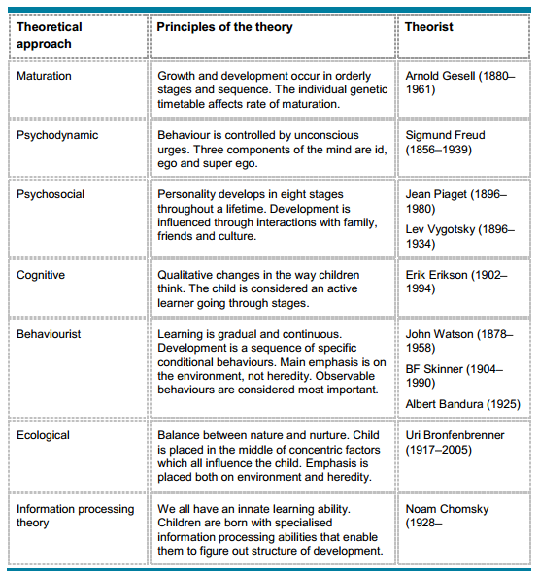
Handout. Main Theorists

Slide 8
Emotional and psychological development

Slide 9
Cognitive development

Slide 10
Emotional Development - Maslow
Abraham Maslow wanted to understand what motivates people.
He believed that individuals possess a set of motivation systems unrelated to rewards or unconscious desires.
Maslow (1943) stated that people are motivated to achieve certain needs. When one need is fulfilled a person seeks to fulfil the next one, and so on.

Slide 11
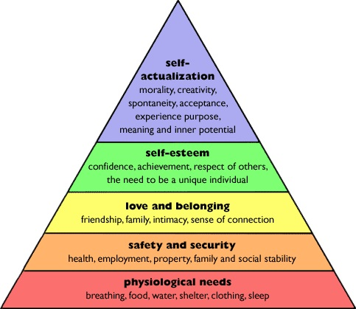

Slide 12
Jean Piaget
Cognitive is a word we use to describe how we think!
Piaget discovered that children think and reason differently at different periods in their lives.
He believed that everyone passed through an invariant sequence of four distinct stages.
Invariant means that a person cannot skip stages or reorder them.

Slide 13
Although every normal child passes through the stages in exactly the same order, there is some variations in the ages at which children reach each stage.
Each stage has major cognitive (thinking) tasks which must be achieved.

Slide 14
His theory of intellectual development is strongly grounded in the biological sciences. He saw cognitive growth as an extension of biological growth and as being governed by the same laws and principles.
He argued that intellectual development controlled every other aspect of development - emotional, social, and moral.

Slide 15
His view of how children's minds work and develop has been enormously influential, particularly in educational theory.
His particular insight was the role of maturation (simply growing up) in children's increasing capacity to understand their world: they cannot undertake certain tasks until they are psychologically mature enough to do so.

Slide 16
He proposed that children's thinking does not develop entirely smoothly: instead, there are certain points at which it "takes off" and moves into completely new areas and capabilities.
He saw these transitions as taking place at about 18 months, 7 years and 11 or 12 years.
This has been taken to mean that before these ages children are not capable (no matter how bright) of understanding things in certain ways.

Slide 17
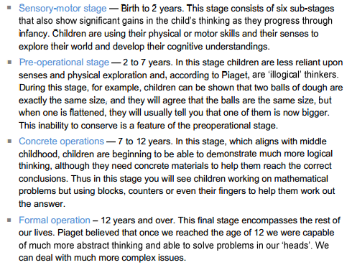
Stages of Cognitive Development

