Slide 1
Operations:
Influences
Notes:
Stacked, 3-D text at dramatic angle
(Intermediate)
To reproduce the text on this slide, do the following:
On the Home tab, in the Slides group, click Layout, and then click Blank.
On the Insert tab, in the Text group, click Text Box, and then on the slide, drag to draw the text box.
Enter text in the text box and select the text. On the Home tab, in the Font group, select Impact from the Font list, and then change the font size of each line so that the text is approximately the same width. For example, if you entered “FIRST” on one line, “SECOND” on the next line, and so on (as shown on the slide), do the following:
Select the first line of text, and then on the Home tab, in the Font group, enter 100 in the Font Size box.
Select the second line of text, and then on the Home tab, in the Font group, enter 70 in the Font Size box.
Select the third line of text, and then on the Home tab, in the Font group, enter 94 in the Font Size box.
Select the fourth line of text, and then on the Home tab, in the Font group, enter 75.5 in the Font Size box.
Select all of the text. On the Home tab, in the Font group, click Character Spacing, and then click More Spacing.
In the Font dialog box, on the Character Spacing tab, in the Spacing list, select Expanded. In the By box, enter 2.
On the Home tab, in the Paragraph group, click Center to center the text in the text box.
Under Drawing Tools, on the Format tab, in the bottom right corner of the WordArt Styles group, click the Format Text Effects dialog box launcher. In the Format Text Effects dialog box, click Text Fill in the left pane, select Gradient fill in the right pane, and then do the following:
In the Type list, select Radial.
Click the button next to Direction, and then click From Corner (second option from the left).
Under Gradient stops, click Add gradient stop or Remove gradient stop until two stops appear in the slider.
Also under Gradient stops, customize the gradient stops that you added as follows:
Select the first stop in the slider, and then do the following:
In the Position box, enter 0%.
Click the button next to Color, and then under Theme Colors click White, Background 1, Darker 15% (third row, first option from the left).
Select the last stop in the slider, and then do the following:
In the Position box, enter 100%.
Click the button next to Color, and then under Theme Colors click White, Background 1, Darker 50% (sixth row, first option from the left).
Also in the Format Text Effects dialog box, click 3-D Rotation in the left pane. In the right pane, click the button next to Presets, and then under Perspective click Perspective Heroic Extreme Left (third row, second option from the left).
Also in the Format Text Effects dialog box, click 3-D Format in the left pane, and then do the following in the right pane:
Under Bevel, click the button next to Top, and then under Bevel click Cool Slant (first row, fourth option from the left).
Under Depth, in the Depth box, enter 70 pt.
Also in the Format Text Effects dialog box, click Shadow in the left pane. In the right pane, click the button next to Presets, and then under Perspective click Perspective Diagonal Upper Right (first row, second option from the left).
To reproduce the background on this slide, do the following:
Right-click the slide background area, and then click Format Background. In the Format Background dialog box, click Fill in the left pane, select Gradient fill in the right pane, and then do the following:
In the Type list, select Linear.
Click the button next to Direction, and then click Linear Down (first row, second option from the left).
Under Gradient stops, click Add gradient stop or Remove gradient stop until two stops appear in the slider.
Also under Gradient stops, customize the gradient stops that you added as follows:
Select the first stop in the slider, and then do the following:
In the Position box, enter 64%.
Click the button next to Color, and then under Theme Colors click Black, Text 1 (first row, second option from the left).
Select the last stop in the slider, and then do the following:
In the Position box, enter 100%.
Click the button next to Color, and then under Theme Colors click Black, Text 1, Lighter 35% (third row, second option from the left).

Slide 2
As with all parts of the business, the operations function is affected by external influences.
Although the business cannot control these factors, good management is about monitoring the external environment and ensuring that the business has the capacity to adapt to these changes and, thus, ensure the sustainability of the business.

Slide 3
Globalisation, technology, quality expectations, cost-based competition, government policies, legal regulation, environmental sustainability

Slide 4
Globalisation
Globalisation has both a positive and negative influence on a business.
It provides the business with new customers, access to new technology and financial markets.
It also gives the business the provision to use cheaper inputs and/or more cost effective production processes.
The operations department may decide to relocate to another country for cheaper labour or more flexible government regulations.
On the negative side, globalisation also means greater competition for a business as it is competing with other businesses overseas.

Slide 5
Technology
For the operations department, having access to new technology will mean that a business can often make its production process more efficient.
Taking advantage of new technology will often provide a competitive advantage; however, implementing this can be expensive.
Technology gives a business access to new production processes and new product lines, but it can also mean that existing products become out dated.
The challenge for the operations department of a business is to ensure that they refresh their product lines and production techniques.

Slide 6
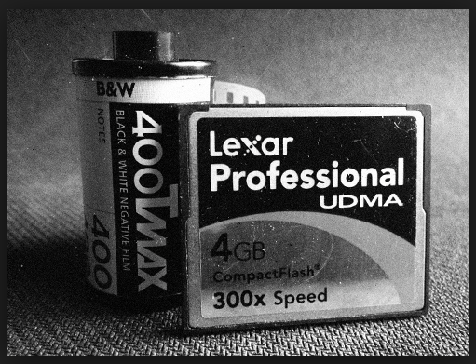
An example of this is when photo labs that processed films had to change their processes when digital cameras became popular.
These businesses had to change so that customers could download their own photos and select which ones to print.

Slide 7
Quality Expectations
Quality expectations of consumers influence a business because if the product or service is not considered good enough, especially compared to the way it is marketed, it can lead to disappointment and consumers taking their business elsewhere.
A business also expects certain quality standards from its suppliers.
If the inputs are not satisfactory then the overall quality of the product/service may be affected.
Similarly, if the quality of the input is too high to suit the needs of the business, then the price of the product is increased to maintain profit margins.
Both situations result in a business potentially losing customers.

Slide 8
Cost based competition
When a business becomes a cost leader, it will attract competition into the market – other businesses that will try to offer a similar product at similar low prices.
An example of this is in Australia is Virgin Airlines, Jetstar Airlines and Tiger Airlines all competing against each other to attract customers to a low price, no frills product.
And, when Burger King offered a $4.95 lunch deal, MacDonald’s soon followed.
Being a cost leader, and maintaining this position, can put pressure on the operations function as management will be constantly having to look for ways to decease production costs.

Slide 9
Government policies and legal regulation
Government policies will influence the production processes of the business.
The government may increase taxes on some inputs making the production of goods and services more expensive.
The government may ban some inputs or a process, leading to costly research as the business tries to find an alternative.
Rules and regulations regarding the operations of the business will also affect the production process.

Slide 10
In regard to supermarkets and banks in Australia, mergers and takeovers are looked at closely, in case they begin to monopolise competition.
On the other hand, the government may create changes that benefit the business; however, these benefits will be available to other businesses to take advantage of too.
On the positive side, rules and regulations create a level playing field for all businesses

Slide 11
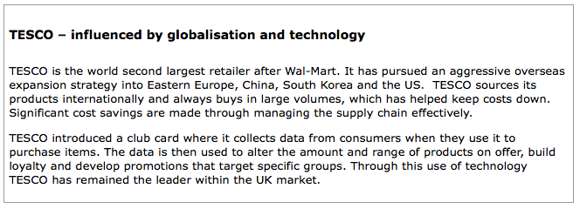

Slide 12
Environmental sustainability and social responsibility
In today’s business world there is a strong emphasis on doing the right thing by society and the physical environment.
In order to attract and keep customers, businesses must be seen to be having practices that lead to environmental sustainability as well as showing a responsibility to the society in which they operate.

Slide 13
It falls upon the operations department of each business to ensure that its production processes do not endanger the physical environment.
This may be expensive for the business but ignoring this responsibility will have the possible repercussions of fines, legal action, loss of investors, negative media coverage and a loss of customers.

Slide 14
Corporate social responsibility
the difference between legal compliance and ethical responsibility
environmental sustainability and social responsibility
Many laws cover the running of a business and failure to follow these laws will lead to a range of legal action resulting in penalties from fines to imprisonment, but, as mentioned above, businesses today are under pressure to behave ethically.
This means doing the right thing by stakeholders, even if it is not a legal requirement.

Slide 15
Nearly all businesses today recognise their role in environmental sustainability, ensuring that resources are used appropriately so that they are available to future generations.
A business that fails to be seen to do the right thing by the environment will lose customers.
Environmental awareness has created new business opportunities for some entrepreneurs and let other business gain a competitive advantage.

Slide 16
A visit to the websites of many medium to large businesses will see that they set out how they show their corporate social responsibility.
For the operations manager it will mean ensuring that production processes do not affect society in a negative way, otherwise it could mean a loss of customers.
Ethical standards may look good to the community but can be expensive to implement.

Slide 17
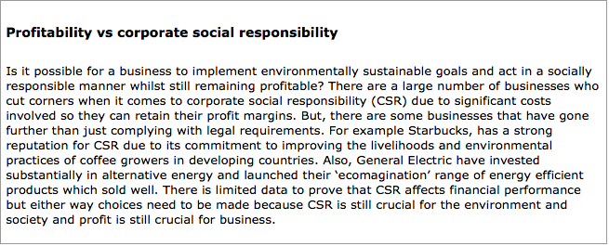

Slide 18
