Slide 1
influences in the business environment
Lesson 7

Slide 2
External v Internal
External are outside the control of the business
Internal are within the control of the business
Sometimes there is overlap

Slide 3
Sources of Change
External
Changing nature of markets
Economic
Financial
Geographic
Social
Legal
Political
Technological
Internal
Accelerating technology
E-commerce
New systems and procedures
New business cultures

Slide 4
External Sources of Change

Slide 5
external influences
Businesses operate in an external environment in which as well as competition from rivals businesses have to take account of legal, political, social and economic influences.
A SLEPT(Social, Legal, Economic, Political, Technological) analysis is often carried out by business planners which enables them to develop more informed strategies (i.e. long term plans).

Slide 6
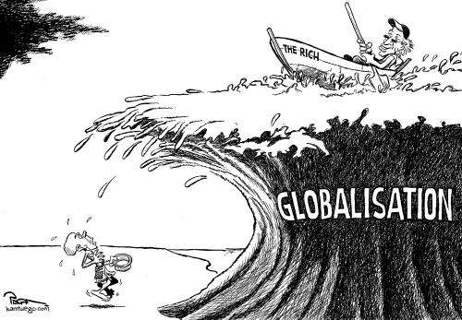
The changing nature of markets
Globalisation:
Process of increasing the connectivity and mobility of the world's markets and businesses.
Why is globalisation a concern for Australian Businesses?

Slide 7
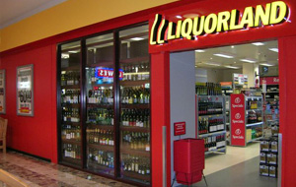
The changing nature of markets
Downsizing
Casualisation of workforce
E-commerce
Dominant Retailers

Slide 8
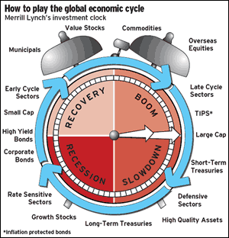
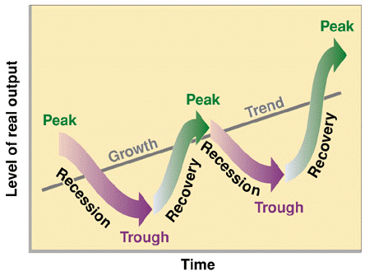
External Influences – The Economy
The Economic Cycle

Slide 9
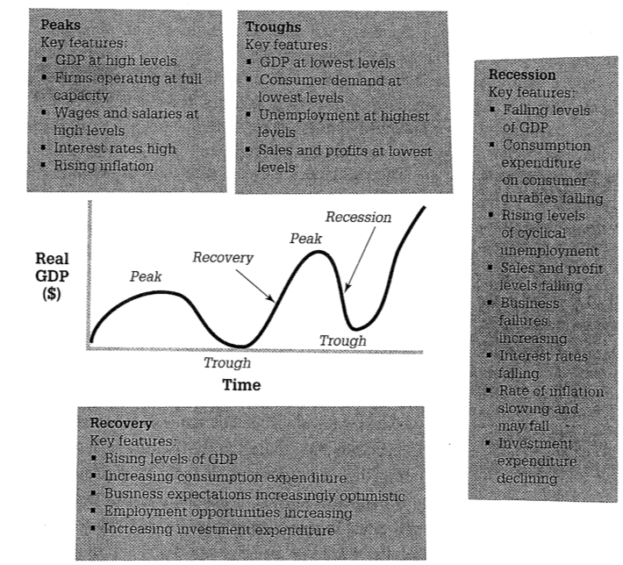

Slide 10
Relate to changes in the wider economy.
A growing economy provides greater opportunities for businesses to make profits, so businesses welcome rising living standards.

Slide 11
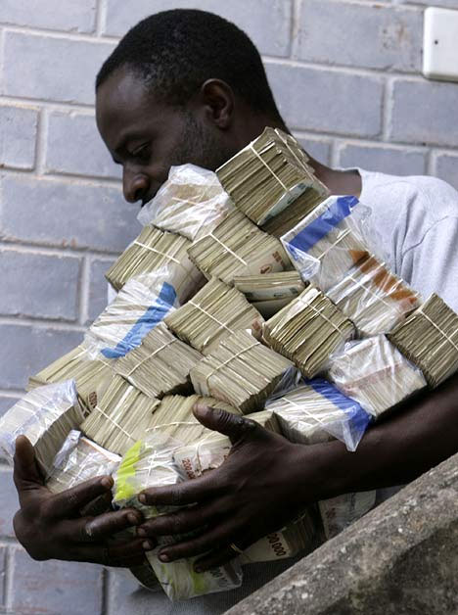
External Influences – The Economy
Information is key
Interest Rates
Inflation
Consumer Confidence
Unemployment Data
Balance of Payments
The picture shows a Zimbabwean carrying pile load of cash to buy something. Seems like a lot of money… but fact is the pile of cash is probably worth less than 100 US dollars.

Slide 12
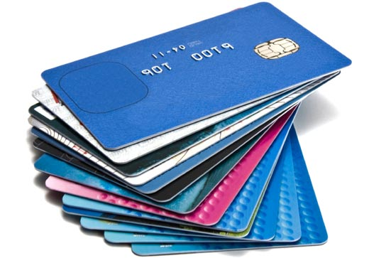
External Influences –Financial Markets
Deregulation by government – market oriented approach
New banks and financial institutions
International sources of finance
Technology allows for new products

Slide 13
External Influences - Geographical
Asia Pacific Region
Demographics
Ageing pop and lower birth rates

Slide 14
social
Relates to change is society and social structures.
Changes in the structure of the population, and in consumer lifestyles and behaviour affect buying patterns.

Slide 15
External Influences – Social Influences
Understanding leads to greater success
Family friendly programs
Make up of the workforce
Environmental movement
Can you think of any other social influences?

Slide 16
legal
Relate to changes in laws and regulations.
Businesses must be careful to keep within the law and to anticipate ways in which changes in laws will affect the way they must behave.

Slide 17
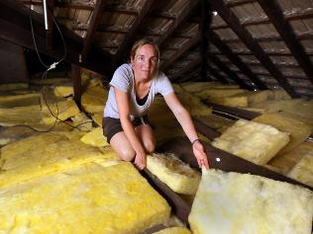
External Influences - Legal Influences
Deregulation: is the removal or simplification of government rules and regulations that constrain the operation of market forces.
Why is this good for businesses?
What is the opposite of deregulation?
Regulation
Can you think of areas of business that have seen increased regulation?

Slide 18
External Influences - Legal Influences
Environmental
Consumer protection
OH&S
Industrial Relations
Trade Practices

Slide 19
political
Relate to ways in which changes in government and government policy can influence business.

Slide 20
External Influences - Political
government regulators – ACCC ASIC
Political parties have different approaches to managing the economy
Tax and areas of Law
Floating of the Aus $ (Dec 1983)
GST was a huge change in 2000
Free trade – removal of protection
Government plays a major role in having a stable economy

Slide 21
Dollar dive: 40 US cents warning - November 1, 2008 - 8:29AM SMH
The Australian dollar may fall to a record low next year, possibly dipping below 40 US cents for the first time, as slowing growth in emerging markets cools demand for the raw materials exported by the nation.
The currency has dropped 31% since reaching a 25-year high of 98.49 US cents on July 16, sliding as prices of crude oil, gold and nickel declined. It reached 47.75 cents in April 2001, the lowest since it started trading freely in 1983.
"I can see it certainly dropping quite sharply from here," Carlin Doyle, a London-based currency strategist at State Street Global Markets said. The Australian dollar could fall "below the 40 cent level and I can see that happening in the next year or so," he added.
Australia's currency rose 5.3% to 68.43 cents at 7:03pm in Sydney, from 68.43 cents late yesterday in Asia.
The currency advanced to its July high as surging commodities prices and a benchmark interest rate of 7.25% helped attract investment. It has been the worst performer of the 16 most-traded currencies against the dollar and yen over the past 3 months as a seizure in credit markets fueled concern the global economy is headed for a recession.
Commodities account for about 60% of Australia's exports

Slide 22
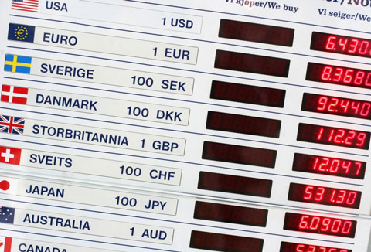
External Influences – Exchange rates
Appreciation – value of $ against other currencies rises, e.g. AUD $1 = USD$ 0.75 to $1 AUD = USD $0.95
Exports harder to sell abroad - foreign traders have to give up more of their currency to get same amount of AUD $ - export prices appear to rise
Imports appear to be cheaper – buyer in AUS gets more foreign currency for every AUD$

Slide 23
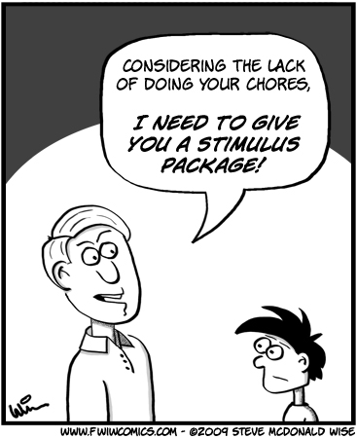
External Influences - Government Policies:
Fiscal Policy – influencing economic and non-economic objectives through variations in public income and expenditure (tax revenue, borrowing and government spending)
Affects all aspects of business activity – regulations, infrastructure – roads, transport, etc, health and safety, support for industry, business taxation, employment laws and taxes – income tax and national insurance contributions, pension contributions, etc.

Slide 24
External Influences – The Macro-Economy
Monetary Policy:
Changes in the rate of interest to help control the level of expenditure in the economy and therefore the level of inflation
In hands of the Reserve Bank of Australia RBA
Significant effects on business activity:

Slide 25
External Influences – The Macro-Economy
Rising Interest Rates:
Likely to depress consumer spending
Increases the cost of borrowing – impacts on investment decisions
Increases existing loan costs – the more highly geared the greater the impact
Affects exchange rate – could impact on sales abroad (exports) or cost of imported resources
Falling rates have the opposite effect

Slide 26
technological
Provide opportunities for businesses to adopt new breakthroughs, innovations, and inventions to cut costs and develop new products.
A business producing confectionery like Cadbury Schweppes examines SLEPT factors in designing new products.
For example, social factors that it needs to be aware of include changing patterns of eating. Today many consumers like to eat 'on the go' so bite sized chocolate treats are in great demand to top up consumers energy supplies.

Slide 27
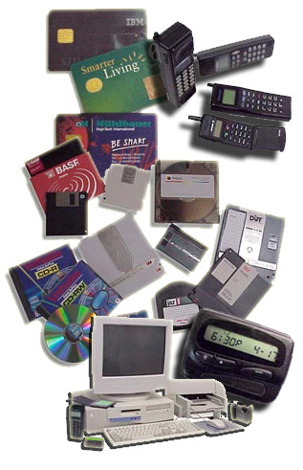
External influences- Technological Developments
Increased productivity
Improved quality and range of goods
Reducing costs
Eliminating boring repetitious jobs
Increases need for highly skilled labour
Emphasis on training

Slide 28
Activities
Evaluate the accuracy of the following statement: ‘One of Australia’s main competitive advantages in terms of world trade is its geographic location within the Asia Pacific Region’
Select two demographic influences on business and explain how they lead to opportunities and threats for businesses.

