Slide 1
Internal Influences in the Business Environment

Slide 2
Internal influences
Internal influences are things that have the potential to affect business performance but that managers can influence.
Managers can often determine the success or failure of a business through decisions to make a certain product, locate a business or the type of resources they will use in the business.

Slide 3
Products
The most important influence from the internal environment is the good the business is producing or the service it is delivering.
A number of businesses will be competing to produce a product that meets the needs of its customers better than its competitors.
The product may be more competitive because it is better quality, or in the opinion of the customer offers better value for money or possibly provides better customer service.

Slide 4
Managers need to be aware of all the things that contribute to the overall customer need and develop a product that meets that need.
The managers of Easyfoods Limited, for example, could have developed products to compete with McCain Foods (NZ) Limited ‘Healthy Choice’ brand, or Heinz Wattie’s Limited ‘WeightWatchers’ brand or Nestlé Australia’s Limited ‘Lean Cuisine’ brand. It would be very difficult to compete with these global businesses in the supermarket freezers!

Slide 5
Instead, the managers of Easyfoods chose to develop products that used a different technology to provide quicker, more delicious, ready meals that better met the needs of specific groups of customers such as those with type 2 diabetes.
The way the managers responded to the internal environmental influence of products is one of the main reasons the business is growing strongly

Slide 6
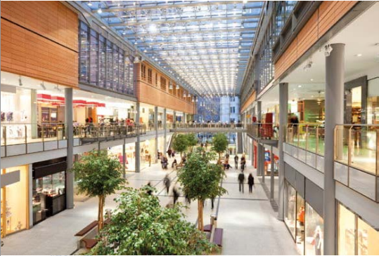
Location
Managers of a business can also choose the location of the business.
Location is an
internal influence
that will have a
strong influence
on the success
of many
businesses.

Slide 7
The success of many of the food franchise businesses such as Gloria Jean’s coffee, Subway, McDonalds or Kentucky Fried Chicken, for example, will depend very much on the location of the business.
In fact, most retail businesses depend on location for their success.

Slide 8
This is why the owners of many retail businesses are prepared to pay very large rents or leases in shopping centres. The shopping centre delivers the ‘passing trade’ essential for a retail business.

Slide 9
Resources
The manager of a business also has control over the resources needed to conduct the operations of the business.
Resources refer to things like finance, employees, equipment and raw materials.
The way the resources are acquired and used will affect things like the quality and value for money of the product and directly impact on the competitiveness of the product.

Slide 11
Management and business culture
Management and business culture refer to the attitudes and values of the managers and employees within the business.
There is an important relationship between the way things are done in a business and profitability

Slide 12
A business culture needs to be based on ‘best practice’ rather than the way things may have been done in the past.
Best practice refers to the way the most competitive businesses in the industry do things and clearly involves ideas such as efficiency, quality production, and high levels of customer service.
Failure to adopt ideas like these may lead to a gradual loss of customers as they switch to businesses that better meet their needs

Slide 13
Managers need to make clear expectations when employees are first introduced to the business and reinforce those expectations through training and rewards.
Bunnings Hardware, a Wesfarmers business, regularly rewards employees demonstrating the attitudes and values in the business culture with small rewards such as $50 vouchers, tickets to sporting and entertainment events and so on.

Slide 14
The most important aspect of an effective business culture is where employees and managers embrace change.
Change provides the opportunities to meet customer needs better than competing businesses.
Where this happens customers change to the business with better products.

Slide 15
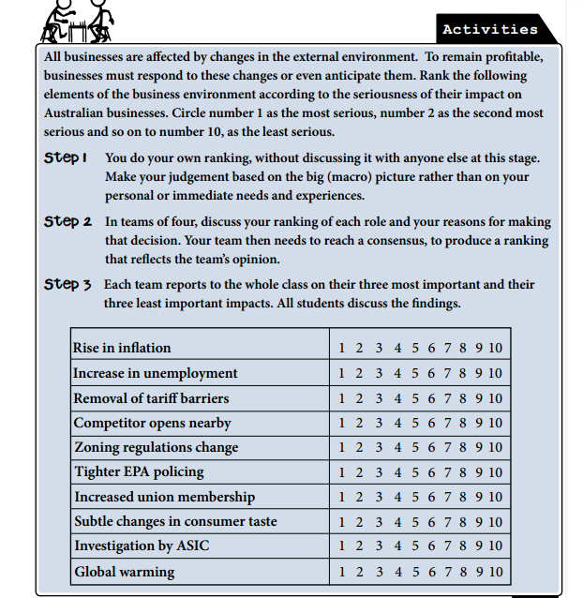

Slide 16
Stakeholders
Stakeholders are any group or individual on whom the decisions or the actions of a business have an impact and who therefore have an interest in the things a business does.

Slide 18
Whenever important decisions are made, effective managers always identify the stakeholders – the individuals or groups - that will be affected by that decision.
The reason is to work out how these stakeholders will react to the decision.
For example, when Rupert Murdoch decided to move the printing of his English newspapers from Fleet Street to Wapping in order to cut costs, he identified the Fleet Street printing unions as groups that would resist the change. He planned for this resistance and the change was effective.

Slide 19
There are both internal and external stakeholders in a business.
Internal stakeholders are those within the business.
They include shareholders, employees and managers.
External stakeholders are those outside the business.
They include investors, customers, suppliers, competitors, unions, government and the community

Slide 21
Effects of an internal Change on Stakeholders
Any internal change will have positive or negative effects on stakeholders.
The major stakeholders affected by an internal change include customers, government, owners, employees and society

Slide 22
Customers
Positive Impact – If the new business strategy, eg marketing campaign, is successful, this will generally result in an increase in customers.
Negative Impact – If the strategy is unsuccessful, the business can expect customer levels to remain the same, despite promotional costs increasing.

Slide 23
Creditors
Positive – Creditors are more willing to give credit if they can make their money back in a timely manner. Successful strategy = easier access to credit.
Negative – If business strategy fails, credit can be more difficult to obtain.

Slide 24
Government
Positive – If a business implements a strategy in line with the government of the day, they may receive incentives and assistance.
Negative – If a company undertakes production methods which go against the government of the day, it may be penalised.

Slide 25
Owners
Positive – Successful business strategy = higher profits
Negative – if new business strategy falls through there could be increased costs and reduction in profitability.

Slide 26
Employees
Positive – successful strategy can mean motivated employees, increase in diversification of job descriptions, opportunity for promotion, wage rises, and increased employee benefits.
Negative – Unsuccessful strategy can mean minimal changes in roles and less opportunity for career advancement. If there is a large increase in costs could lead to redundancy of reduced hours.

Slide 27
Society
Positive – If business strategy is successful society will benefit through increased employment, competition, economic growth and increased product and service diversity.
Negative – If the strategy is unsuccessful the society could be disadvantaged through increased unemployment, less competition, lower levels of growth and less diversity.

Slide 28
Prompt for remembering
C - Customers/ creditors
G - Governments
O - Owners
E - Employees
S - Society

Slide 29
The Effects of an Internal Change on the Financial Situation of a Business

Slide 30
Revenue
Positive – Successful strategy should result in more revenue (The income generated from sale of goods or services)
Negative – If strategy is unsuccessful revenue may fall.

Slide 31
Ownership
Positive – The value of a business may rise and fall. If successful, the business may be bought out, resulting in a change of ownership and rewards for the original shareholders.

Slide 32
Costs
Positive – When implementing a new strategy, costs will initially rise. If successful the cost is covered in the long term.
Negative – If strategy fails, the increase in initial costs will not be matched by cost benefits.

Slide 33
Profits
Positive – If a new business strategy is successful, revenue should rise in turn increasing profits.
Negative – if the strategy is ineffective, the business could experience a decrease in revenues or an increase in costs which both result in lower profits.

Slide 34
Enhancing Shareholder Value
Positive – The increase in value experienced by stakeholders when a strategy is successfully introduced eg. Business becomes more profitable, shareholders receive bigger return on investment.

Slide 35
Dividends
Positive – As shareholder value is enhanced, shareholders/owners can also expect greater dividends/return.
The business may choose to use it’s extra profits to expand or invest into the company.

Slide 36
Share Price/ Value of the Business
Positive – Successful strategy = greater return for investment causing rise in share price. Other investors will pay more for the business or shares in the business.
Negative – Unsuccessful strategy = falling investor confidence and investors selling their shares to minimise loss.

Slide 37
Prompt for remembering
ROCk PEDS
R - Revenue O – Ownership C(k)- Costs
P - Profits E – Enhancing shareholder value D - Dividends S – Share Price

Slide 38
Complete Examining Business Studies worksheets

