Slide 1
Intro to Business Studies

Slide 2
What is it?
Business activity is a feature of everyone’s life. Throughout the world people engage in a web of business activities to design, produce, market, deliver and support a range of goods and services. In addition, investors, consumers and employees depend on the business sector for much of their quality of life.
Brainstorm:
Why do we study business studies?

Slide 3
Business Studies encompasses the theoretical and practical aspects of business in contexts which students will encounter throughout their lives.
Conceptually, it offers learning from the planning of a small business to the management of operations, marketing, finance and human resources in large businesses.

Slide 4
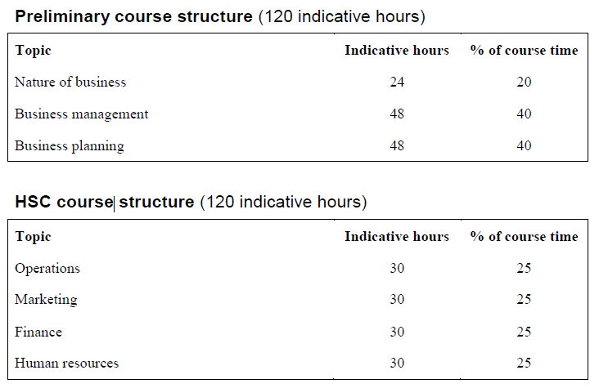
How is the course set out?

Slide 5
What do you want to get out of Business Studies?
In your books, write down what it is that you want to learn in this class.
Why did you choose Business Studies?
What do you hope to get out of it?
How will it help you in the future?
Now compare your answers as a class. Does everyone have similar or different answers?

Slide 6
Key terms to become familiar with
In all preliminary and HSC subjects there are a number or key terms that you will need to become familiar with. These can be found at the board of studies website:
http://www.boardofstudies.nsw.edu.au/syllabus_hsc/glossary_keywords.html

Slide 7
Activity
What are the following questions asking you to do?
Analyse the effectiveness of school rules.
Identify components and the relationship between them
Eg. Look at the reasons for having rules. Based on the reasons, are they effective?

Slide 8
Assess the effectiveness of school rules.
Make a judgement of value, quality, outcomes, results or size
Eg. Do YOU think school rules are effective? Give reasons why or why not.

Slide 9
Discuss the issue of whether or not school rules are effective.
Identify issues and provide points for and/or against
Eg. Look at both sides of the argument. Give reasons and examples for why school rules are effective and why they are not.

