Slide 1
Key Role of Business
Lesson 3

Slide 2
The nature of a business
Review
Businesses play an important part in satisfying our needs and wants as consumers and provide employment to millions of Australians each year.
There are many types of businesses and not all businesses exist in order to earn a profit.
A business is an organisation that attempts to satisfy the needs and wants of the community by providing goods and/or services.

Slide 3
to do this, a business owner must be able to combine a variety of resources to produce goods and/or services.
These resources are known as inputs or raw materials.
Inputs are the resources (such as labour, finance and equipment) that a firm uses to create outputs. For example, the inputs of cans of Coca-Cola include sugar, water, syrup and aluminium cans. The finished product is the Coca-Cola soft drink available for us to consume.

Slide 4
Key Role of Businesses
Role
Profit
Quality of Life
Wealth
Entrepreneurship and risk
Innovation
Choice
Income
Employment

Slide 5
Social and Economic Role of Business
The role of business can be examined from a social and economic point of view.
The economic role of business is concerned with the financial impact that the activities of business have on various groups in the business environment.
Has additional wealth been created for the owners?
Can more people be employed?
Are businesses developing new products and entering new markets?

Slide 6
The social role of business is focused primarily on the impact of business on the community.
How does the community benefit from the activities of business?
Do businesses provide essential services?
Are their actions environmentally friendly?
Does management operate the business in a fair and just manner?

Slide 7
Issues of accountability and ethics are also raised in relation to the social and economic roles of business.
Accountability refers to the process whereby managers are answerable to particular groups affected by the activities of the business.
Ethics may be defined as what is seen as right or wrong based on the values of management, employees and the community.

Slide 8
Profit
The profitability of a business is a key consideration in its long-term survival.
Profit is essential if a business is to meet day-to-day expenses (such as production costs, wages, insurance, electricity and rent) and provide a return on the owners’ financial investment.
It often takes several years of operation before a business achieves a profit.

Slide 9
Business owners will often have different expectations of what level of profit is adequate.
As a general rule, the level of profitability within a business is measured by the return on investment.

Slide 10
The return on investment is the level of profit an investor receives based on the amount that the investor has invested.
This can be illustrated through the following examples:

Slide 11
Example 1
Don invested $200 000 in a cafe and received a net proﬁt of $50 000 in his ﬁrst year. To calculate return:
$ 50 000 x 100 = 25
$ 200 000
The return on investment is 25%.

Slide 12
Example 2
Cheryl invested $100 000 in a children’s clothing store and earned a net proﬁt of
$50 000.
$____?______ x 100 =
$ ?
The return on investment is 50%.

Slide 13
Employment and incomes
In many cases, the owners of a business will employ other people to perform various activities within the business.
Businesses employ over 11 million Australians each year. With this labour, businesses are able to offer the community a diverse range of goods and services. In return for their services, a business will pay a form of income to their workforce.

Slide 14
Over the past 10 years the Australian economy has opened up to increased competition from global businesses.
In response, many Australian businesses have reduced the size of their workforce in order to remain competitive.

Slide 15
For example
since 2000 Telstra has sought to reduce its workforce by more than 35 000 employees to face the increasing threat of foreign owned challengers such as SingTel Optus and Vodafone.
This has helped Telstra to remain competitive.
This process is known as downsizing.
Downsizing occurs when fewer staff are required to work in the business.

Slide 16
Choice
A primary function of business is to produce goods and services for consumers to satisfy their needs and wants.
Most Australian businesses operate in a competitive market environment.
This choice presented to consumers encourages businesses to provide goods and services at the lowest possible price with the highest quality.

Slide 17
Choice encourages business to be innovative and to be different from their competitors.

Slide 18
Wealth creation
Many businesses seek to achieve a profit from their activities.
The production and provision of goods and services is the means by which businesses fulfil this goal.
By increasing sales and developing strategies to promote brand awareness and sales, the management of a business hopes to increase the value of the organisation.
This, in turn, will increase the value of the funds that owners have invested in the business.

Slide 19
Businesses also generate increased wealth for the community.
Profits generated by business are taxed by
the government.
The government uses this taxation to fund essential services; improve educational, health and transport facilities; and employ emergency staff, such as police, fire brigade and ambulance
officers.

Slide 20
Innovation
Innovation can be defined as the process of improving the features of a product.

Slide 21
Technology has played a key role in developing new methods of production that require less labour.
It has also facilitated the development of improved features in many of the products that we use in our day-to-day lives.
For example, mobile phones were once large and bulky with limited uses. Today, mobile phones are compact and offer the consumer the ability to access the World Wide Web, take photos and send images to other users.

Slide 22
Quality of life
In the early 1980s consumers would not have imagined being able to take photographs using their phone or talk to their friends via computer.
Through the variety of products and services provided by business, the quality of life for all Australians has improved.

Slide 23
Business research and development has also contributed to a significant improvement in our quality of life.
Each year governments, research councils and pharmaceutical companies, for example, spend millions of dollars on research and development.

Slide 24
Entrepreneurship
An entrepreneur is an individual who has developed certain ideas and is willing to take a risk to implement these ideas through a business.
Entrepreneurs take risks by developing strategies for their ideas to come to fruition.
Through business, entrepreneurs are provided with an avenue to transform their
ideas into actual goods and services.

Slide 25
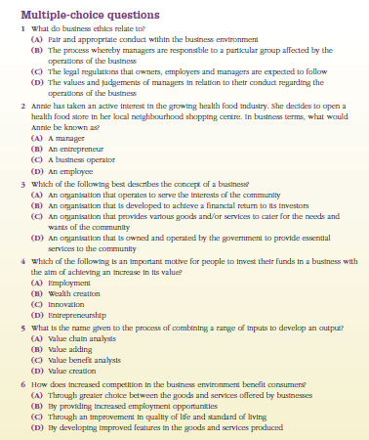
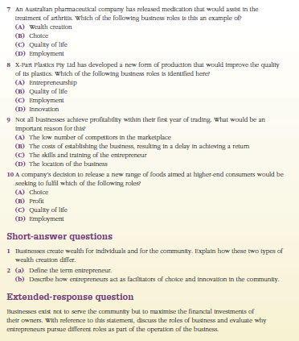
Review
Complete handout of revision questions

