Slide 1
Marketing Process
Lesson 3

Slide 2
Situational analysis – SWOT, product life cycle
Situational analysis – investigates the marketing opportunities and potential problems.
Attempts to answer; a) where is the firm now? B) where will the firm be in the future?
Swot analysis (strengths, weaknesses, opportunities, threats)
Identifies and analyses internal S&W of the business and external O&T on the business
Provides information needed to complete the situational analysis and give a clear indication of the business’s position compared with its competitors.

Slide 3
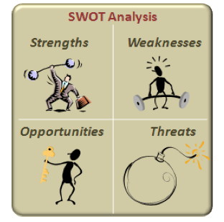

Slide 17
Your turn!
Identify a business you are familiar with.
Fill out the SWOT analysis worksheet in relation to your chosen business.

