Slide 1
Nature vs Nurture

Slide 2
List characteristics (biopotential) that you have inherited from your parents in the format of the table below
2) Who are you most like genetically, your Mum’s side or Dad’s side?
3) List down the aspects of your personality you feel are a product of socialisation (nurture), that is you did not inherit it you just learnt it.
Biopotential Inherited from Mum’s Side | Biopotential Inherited from Dad’s Side

Slide 3
Read article: “Righthandedness”

Slide 4
Answer the following in your books
Why has the analogy of “handedness” been used to help explain a person’s sexual preference?
Is ‘handedness’ a nature or nurture argument?
What does the term inter-sexuality mean?
What do the cases of inter-sexuality and the case of the male identical twins that were raised as separate genders reveal about the nature vs nurture argument?
5. What has anthropologic research discovered about homosexuality?

Slide 5
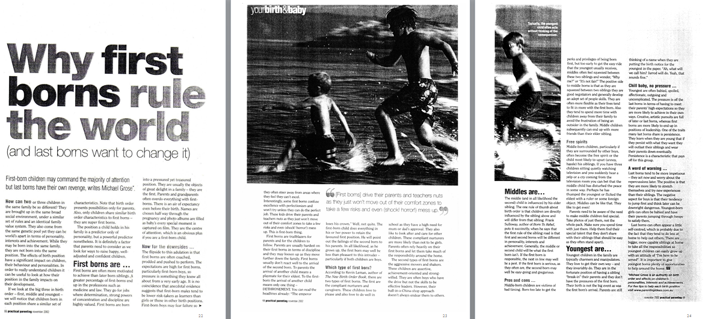
Read the following article:

Slide 6
Nature vs. Nurture: Why First Borns Rule the World
What does the author of this article say is the significant predictor of a child’s personality?
Is this a nature or nurture argument? Justify.
What are typical first born characteristics?
What are typical middle child characteristics?
What are typical youngest child characteristics?
What position are you in your family?
Do the characteristics identified above match your personal experience? If so how? If not why not?

