Slide 1
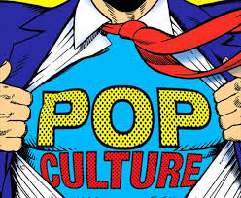

Slide 2
What is Pop culture?
Write down your own definition of what you think pop culture is.
If you cannot think of a definition, write down some examples.

Slide 3
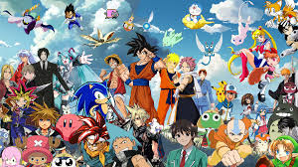
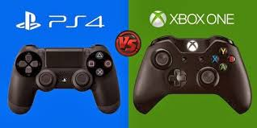
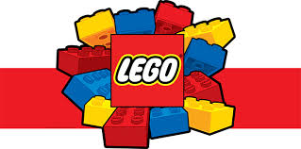
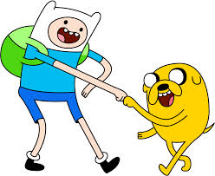
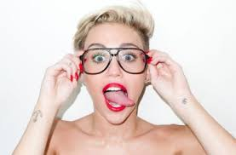
You may have included......

Slide 4
There are four distinguishing characteristics of popular culture.
Each of the following characteristics should be present in an activity for it to be identified as popular culture.

Slide 5
1. Being associated with commercial products
It is important to remember that popular culture is about making money.
No matter how pure the motivation of some of those creating the popular culture, all popular culture thrives on commercial enterprise.
Some examples could be:

Slide 6
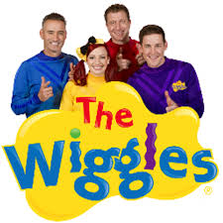
Rock’n’roll music, where the commercial product ranges from CDs to T shirts to magazines.
Kids’ music, where children collect a wide range of merchandise, from groups like The Wiggles.

Slide 7
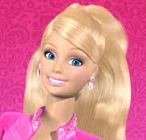
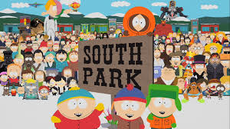
Barbie, where the dolls and associated spin offs have been big sellers for over 40 years.
Animation, where shows like The Simpsons and South Park have spawned T shirts, videos and figurines.

Slide 8
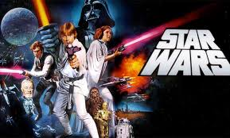
Star Wars, where a science fiction film has emerged as a popular culture in its own right, with videos, books, figurines and fast foods all being associated with the Star Wars phenomena.

Slide 9
2. Developing from a local, to a national, to a global level
It is the global level of acceptance that distinguishes a genuine popular culture from a local cult success.
Although the progress from local to national to global success may not always be clear cut, it should be traceable.
Some examples could be:

Slide 10
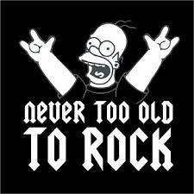
The progress of rock ’n’ roll in the early 50s in the USA.
It started at a number of local levels. Elvis Presley started in Memphis on Sun Records, Chuck Berry in Chicago with Chess, and Little Richard in New Orleans on Speciality.
The key for rock music to move nationally was television shows like Ed Sullivan and Milton Berle, which were shown across the country.
From there rock went global through tours, record releases and films.

Slide 11
The Wiggles started out playing tiny shows at preschools, were signed to the ABC, which gave them national coverage.
Barbie started out as a minor toy in the Mattel catalogue in Hawthorne, California.
They toured nationally, and are currently engaged in widespread touring and promotion in the United States and England.
Through inspired marketing she has moved from a national to an international sales phenomena.

Slide 12
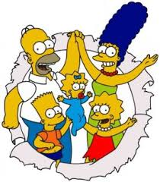
A good example of the process in animation is the emergence of The Simpsons from their brief appearances on the Tracey Ullman Show, to national and then international syndication.

Slide 13
3. Allowing consumers to have widespread access to it
Access is absolutely critical in understanding the nature of popular culture.
Quite simply, without widespread access, nothing can become popular culture.
There are always some barriers, often economic to open and universal access.
Some obvious examples of access include:

Slide 14
Right from the start, rock’n’roll was marketed as teenage music. Its initial consumers were teenagers who could access it through records, radio, concerts, TV, films and magazines.
Most Australian kids have had an opportunity to access music like The Wiggles through the ABC with its national reach. Once the ABC established shops it became even easier.

Slide 15
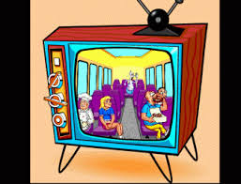
Walk into any toy shop or young girl’s bedroom, and you will find just how easy it is to access Barbie.
Animation discovered very quickly television gave maximum access in the second half of the 20th century.

Slide 16
4. Constantly changing and evolving
Popular culture demands change if it is to remain appealing.
Part of its nature is that once people have consumed what it has to offer, it has to offer something new to retain its market share.
Some examples include:

Slide 17
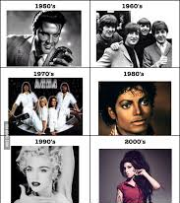
Consider the change in rock music from Elvis to The Beatles to Jimi Hendrix to the Sex Pistols to Michael Jackson to Nirvana.
There are many examples to emphasise this point.

Slide 18
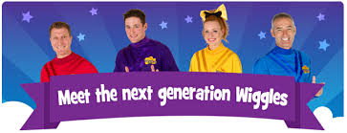
Consider the new characters The Wiggles have introduced to stay fresh and appealing, Dorothy the Dinosaur, Wags the Dog, Henry the Octopus and Captain Feathersword.

Slide 19
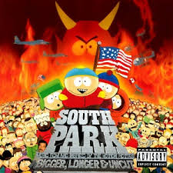
Barbie is a fascinating study of change, and numerous serious sociological studies have been made examining her ability to reflect current social interests and directions.
Even the very change in the content of The Simpsons to South Park shows how animation has constantly pushed at the limits of what is socially acceptable.

Slide 20
Activity
Select 2 examples not already mentioned here of popular culture.
Explain how each of your examples fit the four criteria of pop culture.

Slide 21
pop culture

