Slide 1
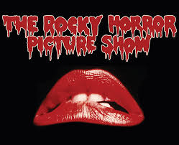

Slide 3
History of Rocky Horror
Rocky Horror began its remarkable life not as a film, but rather as a small production in London that author Richard O'Brien wrote to keep himself busy on winter evenings when he was an out-of-work actor.
It starred O'Brien as a maniacal handyman named Riff-Raff, and another Hair alumnus Tim Curry in the leading role as Dr. Frank-N-Furter, the kinky scientist who creates "Rocky Horror", his personal Adonis.

Slide 4
Characteristic 1
associated with commercial products and paraphernalia:
demand develops and expands due to media, marketing and dissemination processes

Slide 5
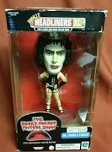
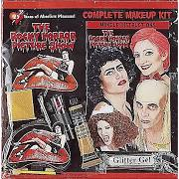
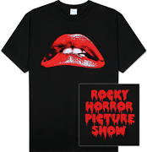
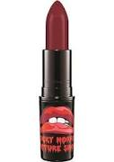
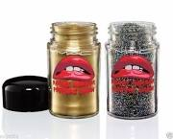
The Rocky Horror Picture Show is widely associated with a vast variety of paraphernalia.
Not only can consumers buy the DVD, soundtrack and posters, other items for sale include makeup kits, costumes, clothing, lipstick, glitter, figurines to name just a few.

Slide 6
Characteristic 2
develops from a local to a global level:
experiences global acceptance with the progression and integration of technologies

Slide 7
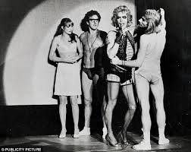
The play opened at the Royal Court 's experimental Theatre Upstairs as a six-week workshop project in June of 1973 to fantastic reviews and packed houses of 60 or so people a night.
The show received such acclaim at this 60-seat theatre that it was quickly moved to larger quarters in a converted cinema in Chelsea .
Following the movie theatre's demolition, the show found a permanent home at the 500-seat King's Road Theatre

Slide 8
Filming of THE ROCKY HORROR PICTURE SHOW began in October, 1974, at Bray Studios, England's famous House of Horror,' and at a 19th century chateau which served once as the wartime refuge of General Charles DeGaulle.
After completing the six-week shoot, it was decided to open a run of the play on Broadway as a sort of pre-release hype, building anticipation for the film's scheduled release the following fall.

Slide 9
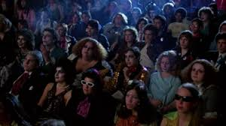
The Rocky Horror Picture Show had its American theatrical debut on September 24th, 1975.
Six months after its initial release, Rocky Horror hit the midnight-movie circuit.
Within weeks, The Rocky Horror Picture Show was also playing at several other theaters throughout the country at the witching hour.
The audience continued to grow steadily and, in addition, began to develop a special relationship with the movie.

Slide 10
In early 1977, the first full-fledged official "dress-up" group emerged at the Fox Venice theater in Los Angeles .
Because of the widespread interest in Rocky Horror, it was decided to stage a major revival of the play in The United States.
The U.S. touring company surfaced in 1980, and played to sell-out crowds wherever it performed.

Slide 11
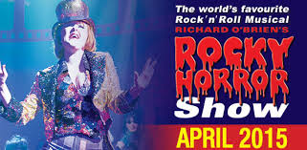
In 2000, The Rocky Horror Show was revived on Broadway with much success and has continued to play to audiences across the world.

Slide 12
Characteristic 3
achieves widespread consumer access:
broad access is assisted by media and communication technologies

Slide 13
Access to Pop Culture can happen in a variety of ways. This can be illustrated in the many ways consumers are able to access the Rocky Horror Picture Show. Some of these ways include:
Movie
Internet articles, fan pages, blogs etc
Soundtrack
Local showings eg. Glen Innes Arts Council are showing the film next weekend at 11pm!

Slide 14
Access has also been granted to wider audiences as the show has been featured in a number of other feature films and television series over the years.
Episodes of Glee, The Drew Carey Show and That 70’s Show spotlight Rocky Horror
“The Rocky Horror Glee Show" aired on October 26, 2010 as part of the second season of the TV series Glee, which recreated several scenes from the film, including the opening credits, and featured Barry Bostwick and Meat Loaf in cameo roles.
Rocky Horror remains a cultural phenomenon today.

Slide 16
Characteristic 4
is constantly changing and evolving:
experiences continuity and change – influences society while simultaneously society influences the popular culture.

Slide 17
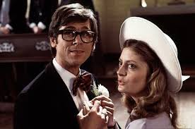
The Rocky Horror Show was originally a small stage production in England.
From this it was produced as a film. Some of the original British cast retained their original roles but other cast members were drawn from America most
notably Susan Sarandon
and Barry Bostwick in an
attempt to engage
American audiences.

Slide 18
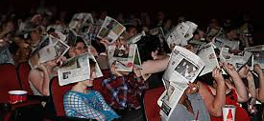
When it became evident that the film was not overly popular it was again reinvented. The film was to be shown at midnight to appeal to it’s small but dedicated fans. Many attended shows numerous times.
The film then evolved into a cult success with audiences dressing up and becoming involved with the show.

