Slide 1
The effect of culture on communication styles

Slide 2
We now know that communication comes in many forms.
Verbal
Non verbal
Written
How does culture impact the way in which we communicate?

Slide 3
Impact of culture
Our culture can impact the way in which we communicate with others.
E.g. In Italy it is socially acceptable for men to greet other men with a kiss on the cheek. However, In Australia this would seem odd and possibly inappropriate.
E.g. Slang words are unique to the country and even the area in which they are derived. This can make cross cultural communication confusing.

Slide 4
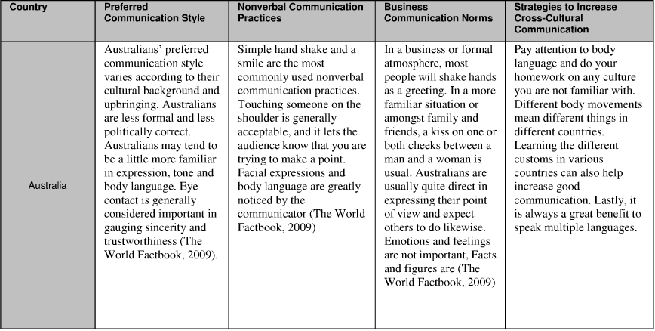
Some examples of differences in communication

Slide 5
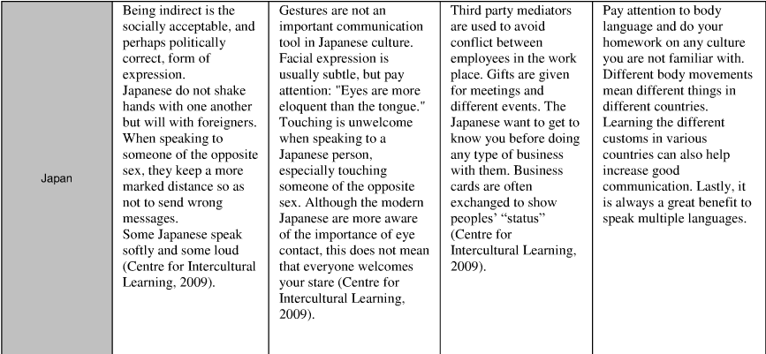

Slide 6
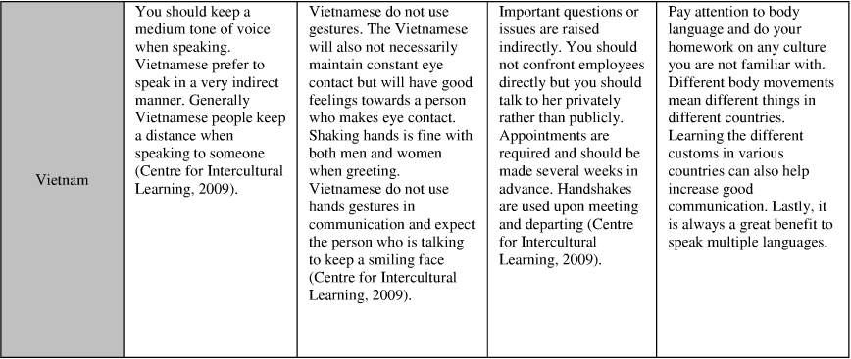

Slide 7
Exercise
In your books write a response of at least 3 paragraphs explaining how culture determines the ways individuals encode messages, what mediums they choose for transmitting them, and the ways messages are interpreted.
Remember to use examples to support your response!!!

