Slide 1
The role of Business
Lesson 2

Slide 2
What is Business?
The term ‘business’ can mean many things to many people. It can be:
A person’s occupation
A type of occupation
A person’s behaviour when they buy and sell (a business man or woman)
To trade or commerce

Slide 3
Business is about buying and selling.
A need is …..
A want is …..
For Sellers | For Buyers
It’s about how they sell How they receive their money and income | It’s about how they get what they want

Slide 4
Business in every day life
It is inevitable that we should come into contact with business in our daily lives. This could be through going to the supermarket, watching television, browsing the internet etc.
Make a list of all the businesses you have had contact with today.

Slide 5
Some examples could have included:
McDonald’s – I drive past their on my way to work everyday and inevitably see the ‘golden arches’ (advertisement)
Apple – I have used my phone
Coles – I bought my lunch on the way to work

Slide 6
Why is business important?
Producing goods and services.
Businesses produce goods and services.
Goods are products which can be seen, handled, turned on, lived in, driven and so on. They are produced by manufacturers who buy raw materials from producers and then add value to turn the materials into
something else.
Other producers of goods combine manufactured goods to construct new products.

Slide 7
Goods can be divided into two kinds:
1. Consumer goods
Consumer goods are goods bought and used by the final consumer.
Consumer goods can themselves be divided into two types:
Single use – They are mainly used just once or by just one consumer and will generally have no other value.
Durable goods – These will generally last a long time and may have a second-hand value which may be greater or less than the original purchase price.

Slide 8
2. Producer goods
Producer goods are goods used by businesses to help to produce goods for other businesses and for consumers.
Handout – goods and services

Slide 9
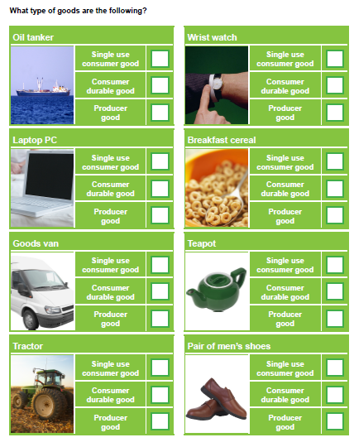

Slide 10
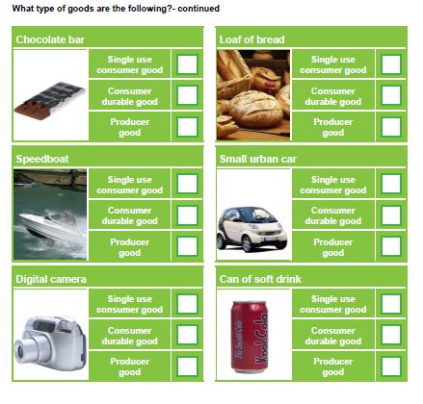

Slide 11
Services
Services are also said to be produced but they cannot be handled or seen. A service is a non-physical item that can be purchased.
Services can be divided into two kinds:
Personal or direct services - aimed at consumers.
Commercial services – aimed at businesses.

Slide 12
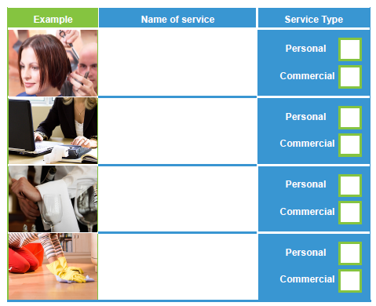
What type of services are the following?
Handout 2

Slide 13
Growing importance of the service sector
Two hundred years ago most workers produced goods, mainly food, close to where people lived and were sold at local markets. The clothes and household goods people needed were also manufactured locally.
As agricultural practices became more efficient fewer workers were needed, but more food was produced.
People moved to the towns, the population grew and most workers were involved in manufacturing cloth, machines, coal and iron.

Slide 14
Over the past fifty years more countries have been producing goods so we have been able to import more of these from abroad.
Improved standards of education and technological developments have lead people to move, in increasing numbers, into the same sector.

Slide 16
Private and Public sectors
Goods and services can be produced by:
The private sector and/or
The public sector

Slide 17
Value adding and output
Value Adding is when a business utilises and combines available resources to manufacture an output.
Adding value = the difference between the price of the finished product/service and the cost of the inputs involved in making it
Eg Consider the examples of new cars rolling down the production line being assembled by robots. The final, completed and shiny new car that comes off the production line has a value (price) that is more than the cost of the sum of the parts. Value has been added. Exactly how much is determined by the price that a customer pays.
An Output is where a business has made goods & services available for sale after they have used various resources to value add to the product/service. Its value can be measured in dollar terms.
EG Roast Leg of Lamb dinner at RSL

Slide 18
A business that successfully adds value should find that it is able to operate profitably. Why? Remember the definition of adding value: where the selling price is greater than the costs of making the product.
When value adding is applied to goods and services, profits are made and businesses are said to be operating successfully.

