Slide 1
Policies and Changes
Topic 2: Development of the cold war to 1968

Slide 2
Policy of Containment
The US would give military and financial support to any government threatened by communist expansion, for example South Korea, Cuba and South Vietnam

Slide 3
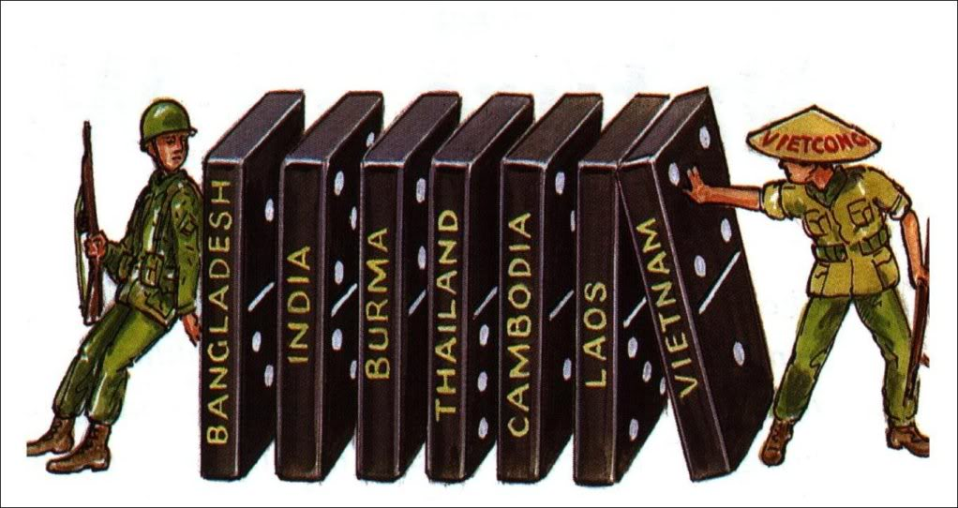
Domino Theory
The theory that the states of South East Asia would come under communist control, unless they were supported with financial and military aid

Slide 4
Peaceful Co-existence
The Soviet Union introduced a policy of peaceful co-existence in the 1950s due to:
Stalin’s death in 1953
Advancement of the US in nuclear weapons
The Soviet Union were surrounded by US supporters in Europe
Yugoslavia would not allow their country to be absolved by the Soviet Union
The Soviet influence in third world countries was declining

Slide 5
Peaceful Co-existence
Malenkhov (one of Stalin’s successors) said: “there is no dispute or unresolved question that cannot be settled peacefully by mutual agreement of the interested countries.”
Soviet citizens who married foreigners were allowed to leave the Soviet Union
Diplomatic relations with Greece, Yugoslavia and Israel were being re-established
The Korean War ended

Slide 6
Peaceful Co-existence
1955 there was a new leader, Nikita Kruschchev
He believed that the Soviet Union needed modernising, that Soviet control should be re-asserted but that nuclear warfare must be avoided
He strengthened relations with other countries and re-built the relationship with China

Slide 7
Berlin Again
In 1958, Kruschchev proposed making Berlin a free city
This was unacceptable to the West because they would lose ground and it would look like they were not supporting West Germany who were becoming an important economic force in Europe
Kruschchev gave the West 6 months to decide, or he would give East Germany access to Berlin

Slide 8
Paris Summit, 1960
The leaders were meant to meet in Paris to make a decision, in 1960
However an American spy plane was shot down over Soviet territory
Eisenhower was forced to admit that it was an American plane
The summit never took place
Peaceful co-existence failed

