Slide 1
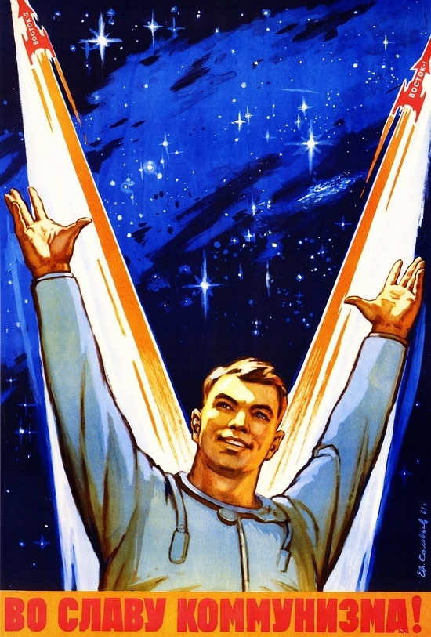
I’m better than you!
“To the glory of communism”
Topic 2 – Development of Cold War to 1968

Slide 2
Superpower rivalry!
Throughout the 1950s and 1960s,
the Soviet Union and the US were
competing to be the biggest and the best.
This time period is famous for the espionage (spying) that was occurring between the two nations.

Slide 3
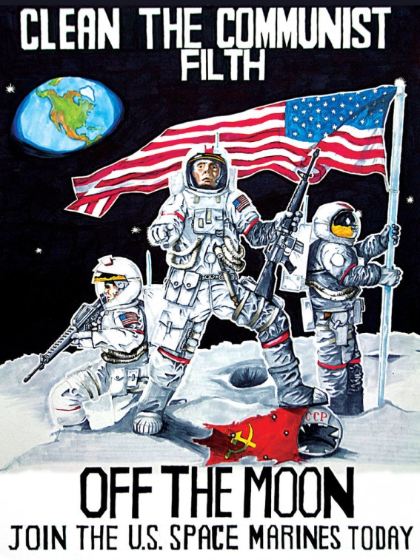
The space race!
The space race had its origins in World War II when Nazi Germany researched and made ballistic missiles
Watch the following clip to see a brief summary of the space race:
http://www.history.com/topics/space-race

Slide 4
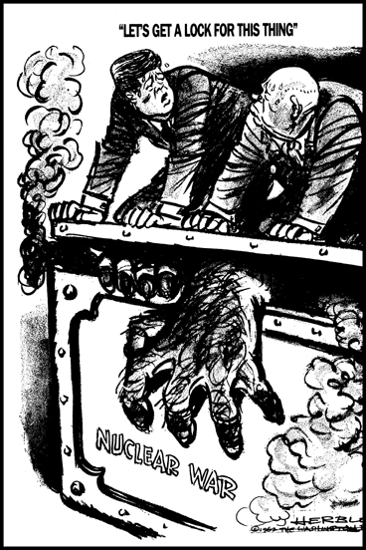

Slide 5
The arms race!
The Soviet Union and the US raced to have more nuclear power than the other
The US acquired the atomic bomb in 1945
The Soviet Union acquired and exploded the atomic bomb in 1949
Both chased after hydrogen and thermonuclear weapons
They possessed missiles to carry the weapons from one continent to the other by the 1960s
Neither super power wanted to use their weapons
The belief was that the cost of nuclear warfare outweighed the possible gains

Slide 6
Timeline
Date | Event
1945 | The US explodes first atomic bomb
1949 | The Soviets explode atomic bomb
1952 | The US explode first hydrogen bomb
1953 | The Soviets explode hydrogen bomb
1962 | Cuban missile crisis
1963 | Nuclear test ban treaty

Slide 7
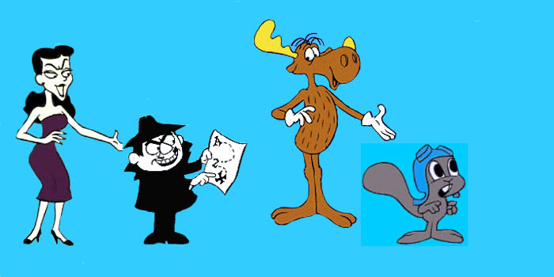
Propaganda
Definition: Information, often biased or misleading, to promote a particular political view point
Both countries used propaganda to win their people to their cause
The Soviet Union – propaganda posters
The US – popular culture
TV/Movies: Roger Ramjet, Rocky and Bullwinkle (cartoon), Get Smart, James Bond, Mission Impossible, Ivan the Terrible, The A Team
http://www.youtube.com/watch?v=SIbFJmCUxsA (Roger Ramjet)
Political Advertisements (election campaigns): http://www.youtube.com/watch?v=dDTBnsqxZ3k (Johnson)
http://www.youtube.com/watch?v=KQNBNiXGMiA (Reagan)
- Political Advertisements (private companies) http://www.youtube.com/watch?v=DWAKtYGJZSM

