Slide 1
The Crises of the Cold War – 1960s
Topic 2 – The Development of the Cold War to 1968

Slide 2
The Berlin Wall - 1961
West Berlin was prospering while East Berlin was floundering
Skilled people from East Germany and other Soviet areas were fleeing into West Berlin
The soviets erected a barbed wire fence through the city, a few months later a permanent wall was built and the city was divided
The wall stood until 1989

Slide 3
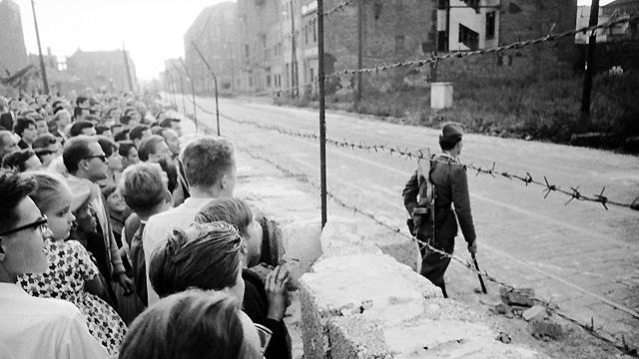
Photo from West Berlin - bbc.co.uk

Slide 4
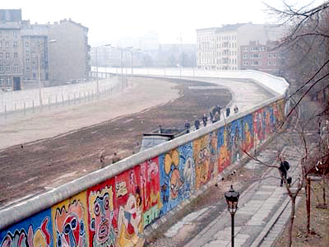
1986 – from West Berlin

Slide 5
Vietnam – 1954-1975
The French withdrew from Vietnam in 1954
North Vietnam was supported Russia
South Vietnam was supported by the US
The country failed to unify
War broke out in 1962, the South supported by the US and its allies
The US withdrew in 1973
The war ended in 1975

Slide 6
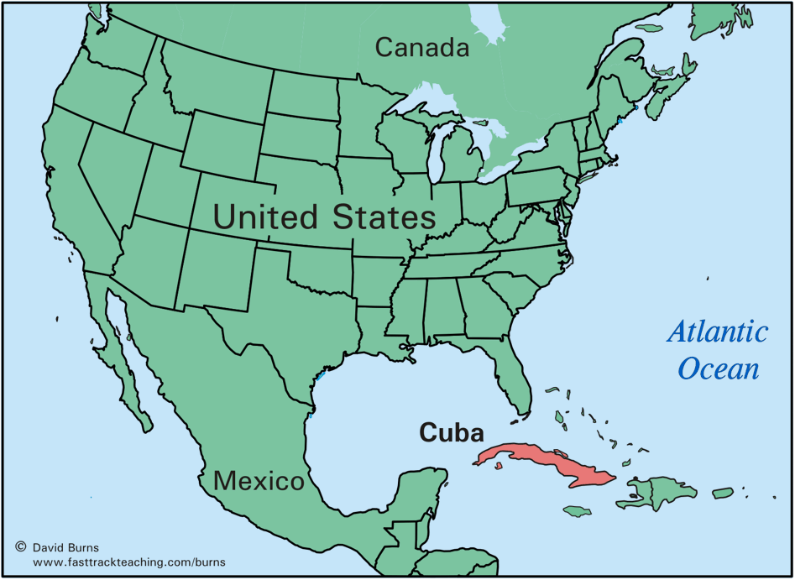
Cuba

Slide 7
The Cuban Missile Crisis 1962
1959: Fidel Castro took control of Cuba and it became communist
1961 the US helped a military coup which failed, named the “Bay of Pigs” Invasion
In 1962 American spy planes photographed missile silos in Cuba and learnt that a convoy of Soviet missiles were on their way to Cuba
America demanded the ships turn back, they set up a blockade and waited for the Russians
The ships slowed and turned back
Khruschchev agreed to remove military equipment from Cuba if Kennedy did the same in Turkey
It was humiliating for the Soviets and seen as a victory from Kennedy

Slide 8
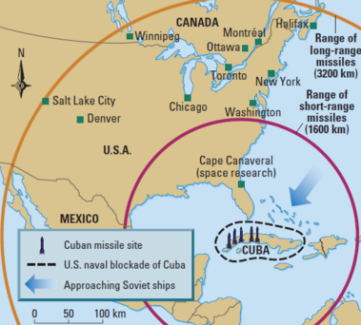

Slide 9
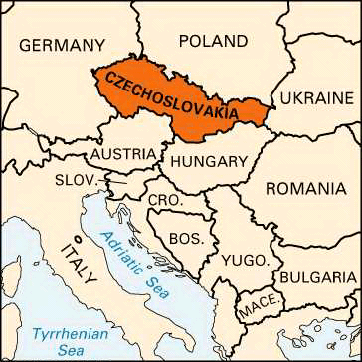
Czechoslavakia
Czechoslovakia was resentful of being under Soviet control
In 1968 the leader, Alexander Dubek announced a new reform that included personal and economic freedoms
The Soviets were unhappy and sent 650,000 troops to Czechoslavakia. They arrested Dubeck and banned all reforms.

