Slide 1
Economic and Political Reasons for Detente- Mid 1960s-Mid 1970s
Topic 3: Detente

Slide 2
What do you think detente means?
?
?
?

Slide 3
Definition
Detente: A French word for slacken, relax or reduce pressure

Slide 4
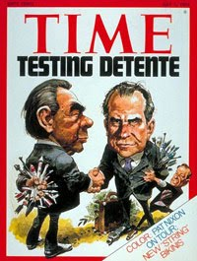
Why did detente occur?
A series of international crises meant that the US and the Soviet Union had to rethink their positions
Historian D McDougall stated that it was a way to gain improvements without being cooperative
The nations agreed to limit the nuclear arms race and establish links across the Iron Curtain

Slide 5
Economic Reasons for detente: The Soviet Union
Khrushchev was dismissed in 1964
The Soviet Politburo (government) faced huge economic problems
In order to improve the standard of living, they had to stop spending money on the military
The soviets could access western technology and food supplies through detente

Slide 6
Economic Reasons for detente: The US
They could spend less on the military and more on social reform – the civil rights movement saw the rise in urban riots
Kennedy had promised a “new frontier” and Johnson a “new society” but had a lack of resources because of military spending

Slide 7
Political Reasons for Detente – The Soviet Union
The Soviet Union could boast that they had stabilised the situation and continued to control Eastern Europe

Slide 8
Political Reasons for Detente – The US
People in America were against communism, politicians could not be seen to be letting the Soviet Union “win” – detente allowed an easing of pressure without an agreement of values
Detente offered negotiation, not confrontation

Slide 9
The Arms Race
The Cuban Missile Crisis had frightened people around the world
By 1969 the Soviets has matched the US for mutually assured destruction
There was a balance of power but the innovations in technology could destroy this balance at any time

