Slide 1
Geo Political Developments – Vietnam, Sino Soviet Split, The Middle East
Topic 3: Detente

Slide 2
The Vietnam War
The US was involved with the Vietnam War because of its policy of c__________ and its belief in d_____________ t_____________ .
The Vietnam War was causing problems in America as people began to think that they should not be invoved
Despite American (and its Allies) efforts, South Vietnam fell to North Vietnam in 1975
Detente offered the US an easing of tension with the Soviet Union, during a political crisis

Slide 3
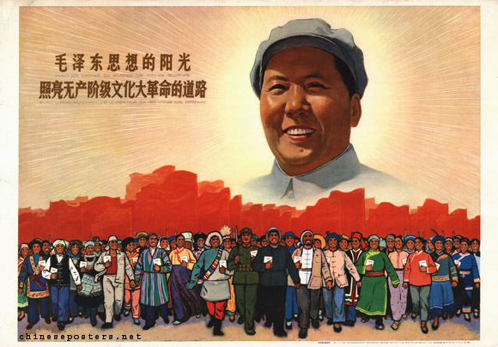
The Sino-Soviet Split
China was gaining in power under the leadership of Chariman Mao Zedong (Tse-Tung)

Slide 4
Krushchev failed to gain a good relationship with Mao, he did not consult with Mao over peaceful co-existence and Mao began to compete with Soviet influence
China encourage Soviet countries to be independent from the Soviet Union and wanted Third World influence
By 1964 China had an atomic bomb
China established a relationship with the US in the 1970s

Slide 5
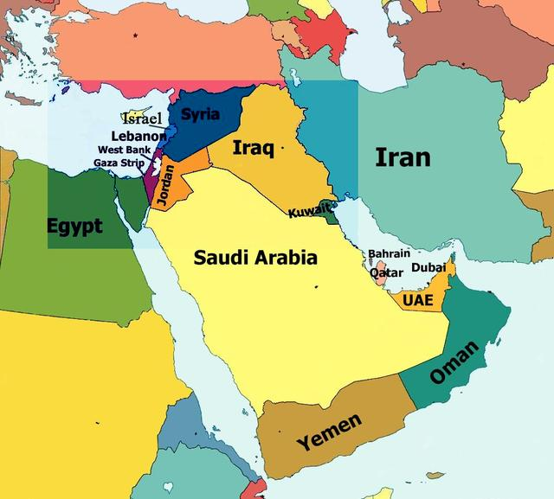
The Middle East

Slide 6
The Middle East was important for both the Soviet Union and the US because of its extensive oil reserves
6 Day War – 10th June 1967: Israel invades Egypt with American arms. It also invades Syria, Jordan, Iraq. Russia supports Syria and Egypt
Yom Kippur War – 6th October 1973: Egypt attacks Israel. Russia supports Egypt and the US supports Israel.
Detente ensured that Russia and the US avoided a conflict with each other, even though they supported opposing sides

