Slide 1
Features and Consequences of Detente
Topic 3: Detente

Slide 2
Arms Limitations
Nuclear Test Ban 1963
Non Proliferation 1968
SALT (Strategic Arms Limitation Treaty) 1969-1972
The Anti Ballistic Missile Treaty
The Interim Treaty (expired in 1977)
The Basic Principles Agreement 1972
The Helsinki Accord 1975

Slide 3
The initial treaties
The Cuban Missile Crisis scared the superpowers and they sought to limit nuclear power
The Nuclear Test Ban Treaty and the Non Proliferation (no growth/no more accumulation) Treaty came out of this crisis
The crisis in Czechoslovakia in 1968 saw this limiting falter from the Soviet Union

Slide 4
SALT 1969-1972
The Anti Ballistic Missile Treaty reduced tension
The treaty limited each country to TWO ABM sites, each side knew that if they attacked the other side COULD strike back. This was a deterrent to nuclear warfare.
The Interim Treaty limited Intercontinental Ballistic missiles and Submarine Launched Ballistic Missiles. It ignored Multiple Independently Targeted Re-entry Vehicles. This situation benefited the US.

Slide 5
SALT
The Basic Principles Agreement, 1972, laid down the conduct for nuclear war
It called for: peaceful co-existence, the avoidance of military confrontations and no claims of spheres of influence
The Seabed Treaty, 1971, banned the placing of warheads on the seabed

Slide 6
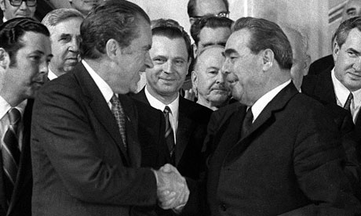
SALT
During the SALT period, Nixon visited Moscow in 1972 and 1974; Brezhnev visited Washington in 1973
Trade was also encouraged

Slide 7
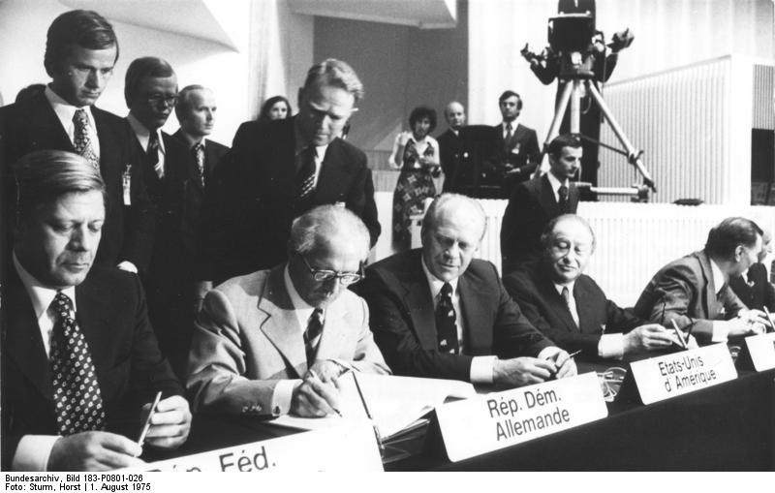
The Helsinki Accord 1975
All European countries, the US and Canada participated in a conference to recognise the existing borders as set at the end of World War II.

Slide 8
The end of detente
In 1979, the Soviet Union invaded Afghanistan and the period of detente was over.

