Slide 1
Soviet invasion of Afghanistan and its impact
Topic 4: Renewal and End of the Cold War

Slide 2
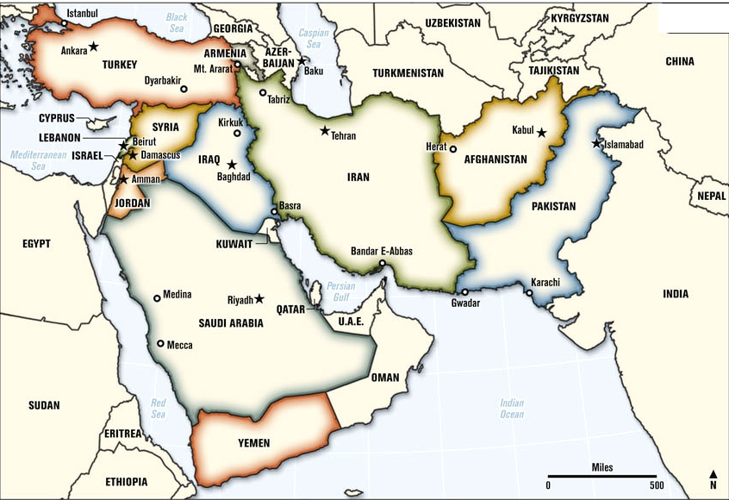

Slide 3
THE CONFLICT
The US, Russia and China were all interested in the Middle East due to its oil
Afghanistan was becoming increasingly unstable due to Islamic fundamentalism
25th December 1979, the Soviets invaded Afghanistan, over 100 000 Soviet troops overtook the country

Slide 4
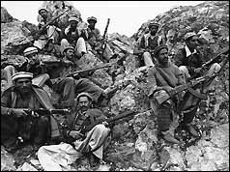
THE RESPONSE
The US issued a formal note of protest and the period of detente ended
The US withdrew from the Moscow Olympic Games (1980) and would not ratify the SALT II treaty
The US imposed economic sanctions on the Soviet Union and helped the Afghanistan rebels

Slide 5
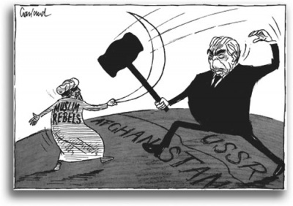
THE RESULT
After a long struggle, the Soviets withdrew from Afghanistan in 1990
This crisis contributed to the collapse of communism in the Soviet Union

