Slide 1
US attitudes and policies under Reagan Soviet attitudes and policies under Gorbachev
Topic 4: Renewal and End of the Cold War

Slide 2
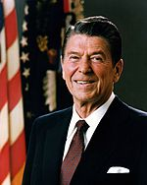
US Attitudes and the Reagan Government
Events in the 1970s had caused
low morale and a lack of confidence
in the government ( The Vietnam War,
Richard Nixon’s Watergate scandal, The
Iranian Hostage Crisis)
This resulted in a decline in the US’s military power, economic problems and a decline in productivity

Slide 3
Reagan: 1981-1989
Reagan beat the sitting president in a landslide – 1980 election
Reagan’s government doubled the defence budget
Cold War tensions increased in the early years of his presidency – in the campaign he called communism “a form of insanity that is contrary to human nature.”
In 1983 he called the Soviet Union an “evil empire” and called for a space missile defence system called “Star Wars”
Provided aid to Soviet freedom fighters and supported anti communist revolutions

Slide 4
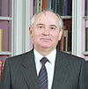
Soviet Attitudes and Gorbachev’s Government
1985 Mikhail Gorbachev became the General Secretary of the Communist Party
He was an agricultural specialist
Gorbachev stood for openness and wanted to restructure the Soviet Union
Reagan and Gorbachev started to work together
Gorbachev:
- Relied less on the military, withdrew troops from Afghanistan and Europe, settled conflicts in third world countries, made agreements with the US

