Slide 1
Collapse of communism in Eastern Europe and the USSR
Topic 4: Renewal and End of the Cold War

Slide 2
The Union of the Soviet Socialist Republics (USSR) officially dissolved on 26th December 1991

Slide 3
The Revolution of 1989
The easing of Russian control over the Soviet states saw different Soviet states revolt against the USSR
Poland, Hungary, East Germany, Czechoslovakia and Romania all revolted

Slide 4
The Fall of the Berlin Wall
9 November 1989
Symbolic fall of Communism
Occurred after months of peaceful protests

Slide 5
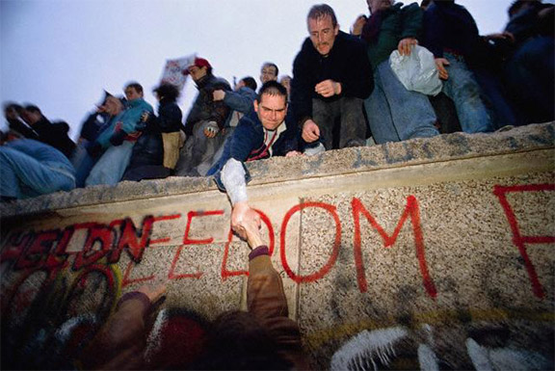

Slide 6
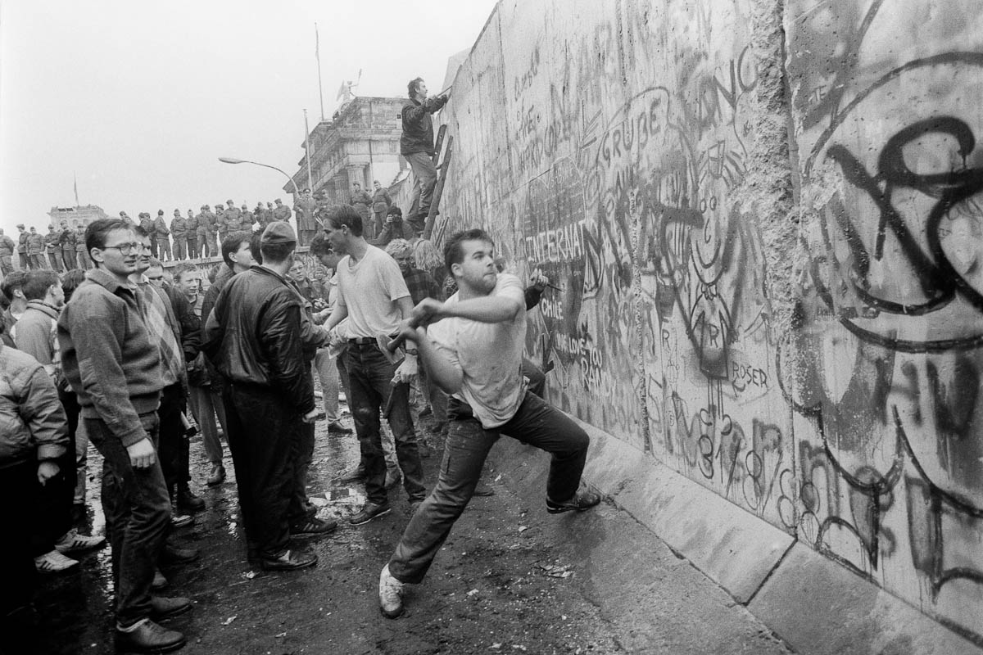

Slide 7
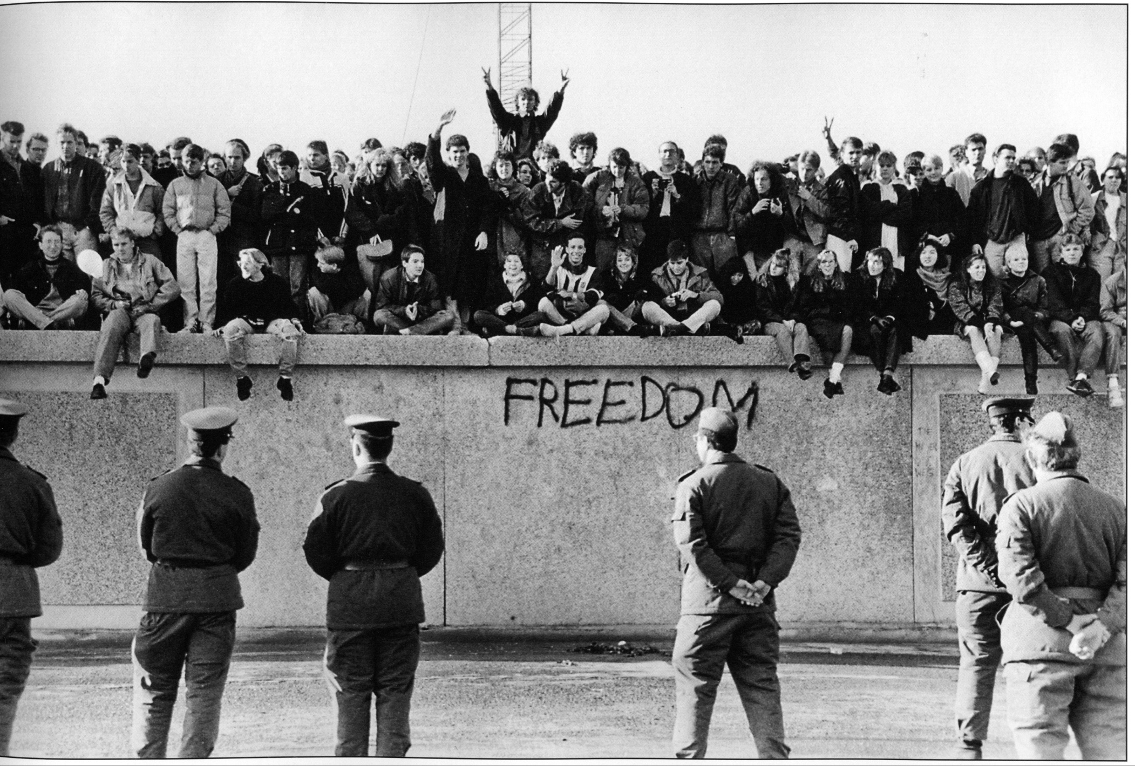

Slide 8
Gorbachev resigned on the 25th December 1991, the Soviet Union was dissolved the next day

