Slide 1
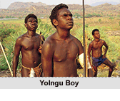
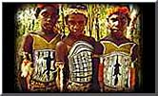
Yolngu Boy

Slide 2
The Yolngu refers to the traditional custodians of what is called north-eastern Arnham Land in the Northern Territory.
With a culture that can claim more than 40 000 years of continuous evolution, the Yolngu have only had regular contact with Europeans since 1935.

Slide 3
In the film ‘Yolngu Boy’ the split of socialisation factors and identity is captured beautifully in the 3 boys: Lorrpu, Botj and Milika.
They are interested in football, girls and music, while also facing the choice of whether to proceed with traditional initiation into the laws and knowledge of the Yolngu.
These internal tensions will be recognised by many adolescents struggling with their own developing sense of identity.

Slide 4
Characters

Slide 5
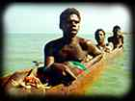
Lorrpu
Believes strongly in the traditional ways of life.
Looks forward to the ceremony that will mark him as a man.
Troubled by his friend Botji’s abandonment of tradition.
Believes in the bond of friendship.
When he dreams he dreams of the boys as younger children following tribal traditions and operating as a harmonious unit.

Slide 6
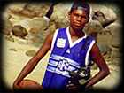
Milika
Not very interested in Yolngu traditional life.
Dreams of being a professional football player.
Lost respect of Botji since Botji has stopped behaving responsibly.
Still shares a strong bond of friendship with Lorrpu.

Slide 7
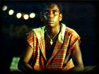
Botji
Caught in the conflict between 2 worlds – traditional and white man’s.
Addicted to sniffing petrol and has fallen into a destructive lifestyle.
Once a strong leader of the boys, he now feels like an outsider.
The community thinks he will become a drunk like his father and does not consider him ready for ‘ceremony’.
On the boy’s journey, Botji discovers the person he used to be.

Slide 8
Rites of Passage in Yolngu Boy
Story follows the growth of the three boys as they move from childhood to adulthood.
Shows the process is not always easy.
The film begins and ends with the boys participating in ceremonial rites of passage.

Slide 9
Beginning
In Lorrpu’s dream we see the initiation of the boys into the tribe.

Slide 10
End
We see Lorrpu and Milika participating in the ceremony marking their transition to adulthood.

Slide 11
Personal Rite of Passage
The boys also make a personal rite of passage.
They undertake the journey from Arnham Land to Darwin.
They learn that sometimes the values that are important to them conflict
with each other, and that
sacrifices must be made.

Slide 12
Questions
How does the movie demonstrate the idea that our choices lead to our growth?
What celebrations and rituals do the boys participate in that mark a transition in their development?
How does the film demonstrate the inevitability of leaving childhood behind?
What does it mean for you to move from childhood to adulthood?
What evidence would you use to show that the three boys have been influenced by western culture?
What evidence would you use to show they have been influenced by Yolngu culture?

