Slide 1
Focus Area 5A4 Australia in Its Regional and Global Contexts
AID

Slide 2
Syllabus Agenda
At least ONE regional and global link chosen from aid, defence, migration or trade:
-The nature of the link.
The roles of the government and
non-government organisations in relation
to the link.
Treaties and/or agreements relevant to the
link.
Cultural, economic and geopolitical
advantages and disadvantages to Australia.
Social justice and equity issues in Australia
and other countries.

Slide 3
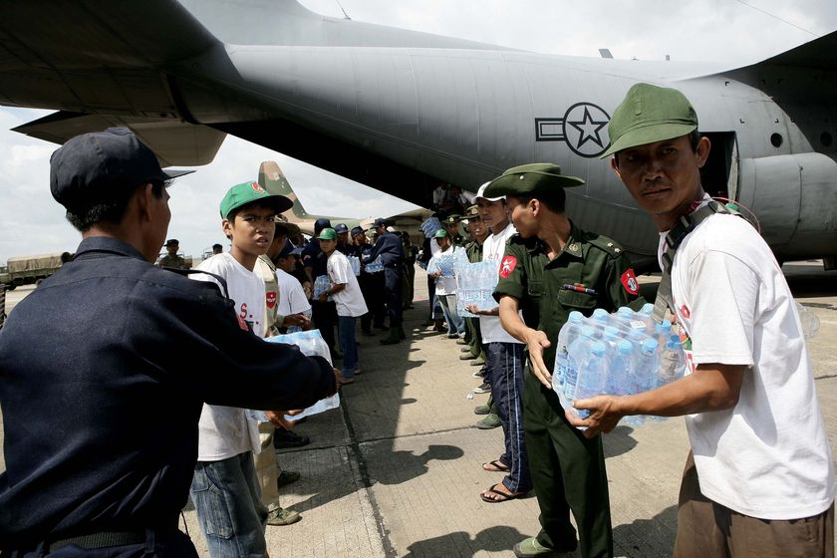
AID
Definition – International or foreign aid – the money or resources given or lent to poor or developing countries whose people have lower living standards than those of wealthier developed countries.

Slide 4
Types of Aid
Governments provide grants and loans as part of Overseas Development Assistance (ODA). Loans need to be repaid but grants do not.
Aid from non-government organisations (NGOs) and non profit comes from voluntary donations, banks and other financial institutions.
Developed nations contribute
US$78 billion a year in aid.

Slide 5
Lingo List
Aid
Alliance
APEC
Asia Pacific region
AUSAID
Australia's Neighbours
Bilateral
Convention
Culture
Developing country
Free Trade Agreement
Geopolitical
Grass Roots aid
Gross national product (GNP)
Human development index
Humanitarian Aid
Infant mortality rates
Multilateral
NGO (Non Government Organisations)
Non Profit
Population
Population growth rate
Strategic
Treaty
United Nations
World Bank
World Health Organisation
World Vision

Slide 6
The 7 Categories of International Aid Australia provides
Make a poster of the 7 categories of Aid – use examples from the past 12 months

Slide 7
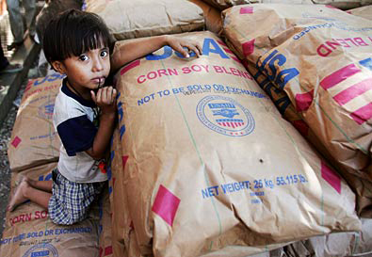
The role of Government – Bilateral and Multilateral aid
Bilateral aid – financial assistance given directly from one government to another, also known as government to government
Multilateral aid – financial assistance that is given by governments through international banks or organisations.
Outline the difference between bilateral and multilateral aid.
Using the AusAID website (www.ausaid.gov.au)
Give an example of bilateral and multilateral aid.
Give two examples of food aid, emergency aid and technical assistance

Slide 8
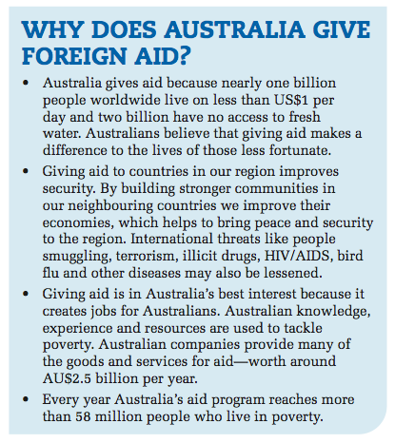
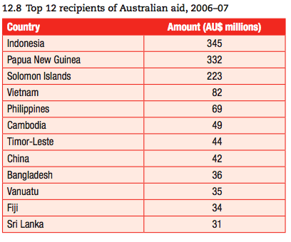
The Role Of The Australian Government In Providing Aid
The Australian Government donates AU$3 billion (0.3% of Australia’s gross national income) each year to overseas countries with low living standards.

Slide 9
http://www.youtube.com/watch?v=XrYsQHK-_yw

Slide 10
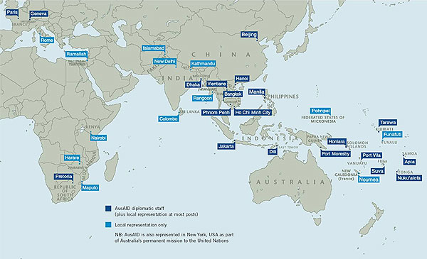
Funding Australia’s Aid Program
The Australian Government funds its aid program with revenue raised by taxes levied on Australian citizens. Australians contribute an average of $2.40 per capita on average each week.
Australia’s government aid is managed by AusAID (the Australian Agency for International Development)

Slide 11
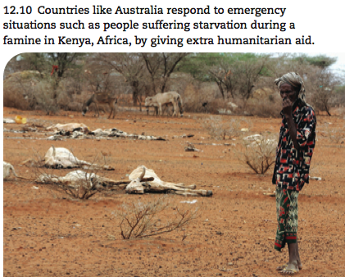
Recipients of Australian Aid
Australia’s main focus of aid is through bilateral aid programs within the Asia-Pacific region.
AU$650 million is given as contributions to organisations like the Asian Development Fund and the World Bank.
Other contributions are made to United
Nations development organisations and
the World Health Organisation (WHO).
Extra humanitarian aid is provided to
developing countries that experience
unforeseen emergencies like Kenya &
the Horn of Africa

Slide 12
(a) How Is Australian Aid Spent?
AusAID contracts aid work to companies and NGOs like World Vision who deliver aid projects and train local people to continue them.
AusAID works with governments of developing countries to improve their economy and services including health, education, sewage and prisons. Projects have been set up to help rural and agricultural communities become more productive and self sufficient.
Internet Activity Go to AusAID website (www.ausaid.gov.au). Go to tab Australia’s Aid Program.
Find out the methods used to deliver aid.

Slide 13
Internet Activity
Go to AusAID website (www.ausaid.gov.au)
Go to countries tab
Select a country
Using comic life show
where the country is
located and outline three
specific projects or aims
that are undertaken by
AusAID in that country.
Include an image of each
project.

Slide 14
(a) International Trade Treaties and Agreements
A treaty is an agreement between countries that is bound by international law.
It is also known as a convention, protocol or covenant.
It contains a series of articles that state the terms of the treaty.
When a country signs a treaty and legislates to make the treaty obligations part of its law it is called ratifying a treaty.
Answer the following questions
What is a treaty?
What are treaties also known as?
What are the article in a treaty?
If a country ratifies a treaty what is it doing?

Slide 15
(a) Treaties That Australia Has Ratified
Go to http://www.ausaid.gov.au/search/default.cfm
Search for a treaty Australia has signed with another country on aid other than those mentioned above.
Identify the name of the treaty and the signatories.
Describe the purpose of the treaty.
Outline the importance of the treaty to Australia and the other country or countries involved.

Slide 16
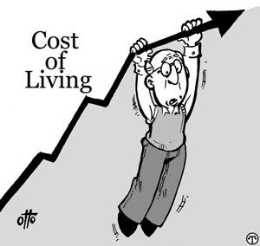
Cultural, Economic And Geopolitical Advantages
Benefits of receiving aid
in developing countries:
Economic growth
Higher SOL (improved health,
education, and infrastructure)
The promotion of greater political stability through democracy, freedom and human rights.
Sustainable development
Improved social justice and equity

Slide 17
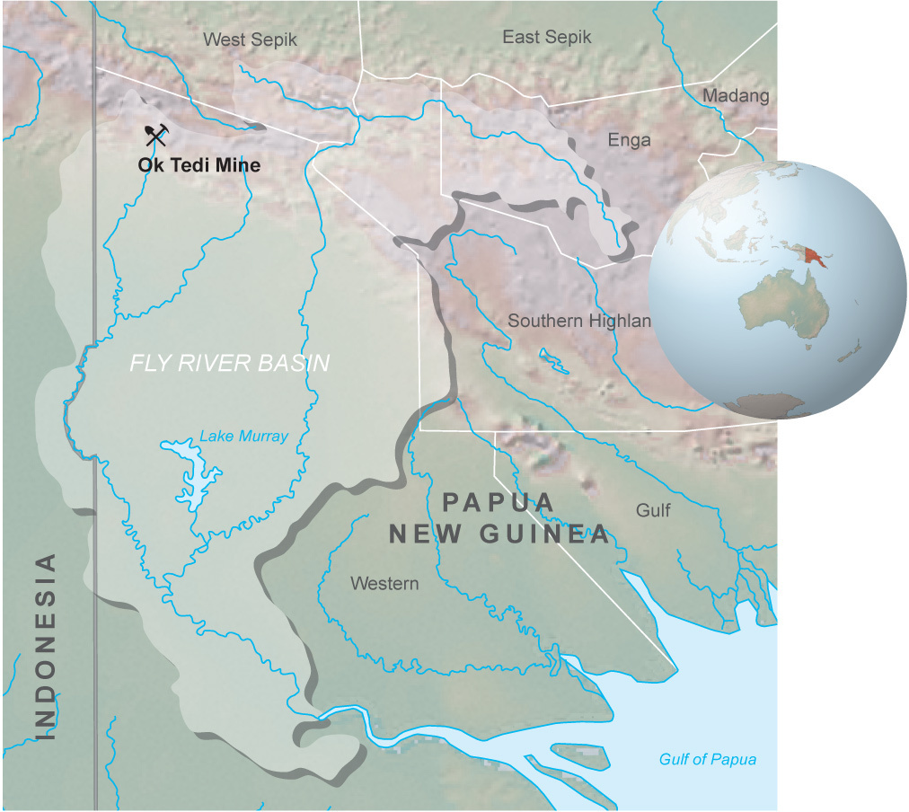
Cultural, Economic And Geopolitical Advantages To Donor Country - Australia
Benefits for the donor country:
Aid strengthens economic, political, strategic and cultural ties between countries.
Economic advantages
Much aid given is tied aid which requires the recipient to spend some of the aid on Australian goods and services creating job opportunities, increasing export sales and providing access to new and future markets.
Australia gains preferential treatment in access to natural resources like oil. For example BHP mined copper at the Ok Tedi mine in Papua New Guinea.

Slide 18
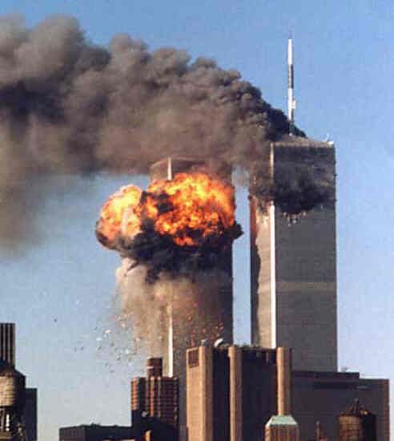
Cultural, Economic And Geopolitical Advantages To Donor Country - Australia
Benefits for the donor country:
- Geopolitical and strategic advantages
Australia aims to improve political stability and security within the Asia-Pacific region.
By addressing poverty it is hoped civil unrest, refugees and terrorism may be reduced.
Access is gained to military base to solidify alliances.
Diplomatic ties are strengthened. Australia signed free trade agreements with Thailand in 2005 and Singapore in 2003.

Slide 19
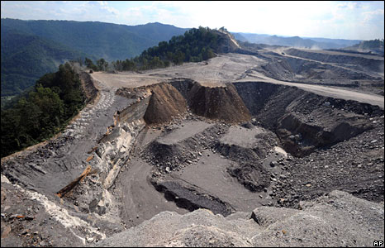
Cultural, economic and geopolitical disadvantages
Costs for recipient nations:
Environmental
Large scale projects like mines
can have negative impacts on
the environment.
Social and cultural
Decisions about the use of aid do not always consider the local cultures and society.
The country may end up being over-dependant on aid.

Slide 20
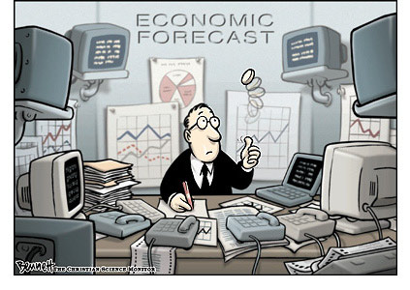
Cultural, economic and geopolitical disadvantages
Costs for recipient nations:
Economic
Making countries buy goods and
services from the donor country
reduces competition, results in price
increases and waste of aid money.
Companies receive less money so remain dependant on aid.
Geopolitical
Aid given to a country’s government may not reach the people who really need it.

Slide 21
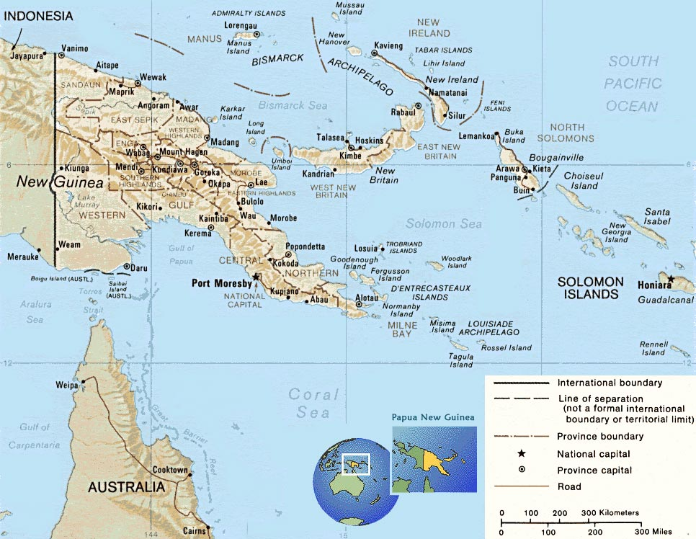
Cultural, Economic And Geopolitical Disadvantages For Donor Country - Australia
Costs for donor nations:
Giving aid can result in a culture of dependence. This is of concern in Papua new Guinea as Australian Aid makes up 80% of the annual budget.

Slide 22
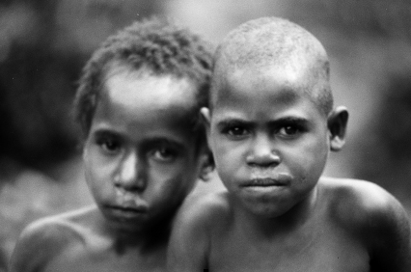
The role of NGO’s in aid
Non government organisations (NGO’s) are non-profit organisations that gain at least part of their funding from voluntary donations made by the public.

Slide 23
The purpose of NGO’s
NGOs help the Australian
Government deliver
overseas aid. They:
Mobilise support and
donations from the
Australian public.
Provide emergency and humanitarian assistance in emergencies.
Have links with community groups in developing countries and are able to work in areas that do not receive government aid.

Slide 24
NGO’s operating in Australia
Using word art develop a collage of as many of the 80 NGOs as possible operating in Australia. Include a brief description of the work of five of these.

Slide 25
Internet Activity – Choose one of the organisations shown in 12.28. Access the web page of that organisation by visiting the Australian Council for International Development http://members.acfid.asn.au/directory.php
Write a report that covers the following:
When did the organisation originate and what is its history?
What does the organisation do?
What are the mission are/or aims of the organisation?
How does the organisation contribute to the provision of overseas aid?
Briefly outline two of the specific programs this organisation has undertaken.
On a world map mark the countries in which this organisation work.
How does the organisation raise the funds?

Slide 26
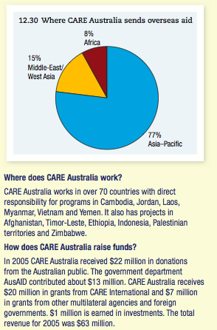
Care Australia
Answer the following questions
When and why was the CARE Australia organisation formed?
What does CARE Australia do?
Outline the main areas of the world in which CARE Australia works.
Draw a table to show how CARE Australia raises its funds.

Slide 27
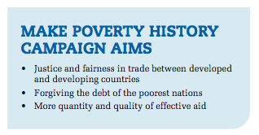
Social justice and equity issues in Australia and other countries
Today individuals have greater knowledge of how aid money is spent. They have the opportunity to lobby governments and organisations to change or be accountable for their actions.
The Make Poverty History campaign was launched on the British TV show The Vicar Of Dibley on New Year’s Day 2005. The campaign uses a variety of means to raise public awareness and pressure governments, including:
the organisation of the Live 8 concerts around the world,
direct protests at the site of the meeting of G8 nation leaders,
the selling of white armbands advertising the campaign and
an extensive website and educational campaigns,
MAKE POVERTY HISTORY
Look at the make Poverty History campaign website. How important do you think this campaign is? Is it effective?

Slide 28
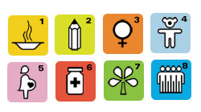
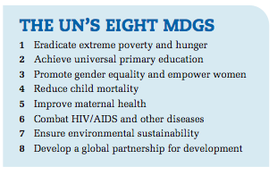
The Millennium Development Goals
Internet Activity - Visit the site
http://www.un.org/millenniumgoals/
Identify the symbol to represent each goal.
Open the fact sheet for each goal.
What are the targets for this goal?
Outline the achievements so far.
Look at the MDG Monitor for the goal. Choose a country. Use a statistic to describe its progress in achieving the goal.
The UN’s Millennium Development Goals (MDGs) were adopted in 2000.
They are a set of eight goals agreed to by all the world’s governments to build a better world.
It is hoped the goals will be achieved by 2015 if governments in developed and developing nations, NGOs, individuals and groups all work together and keep their promises.

Slide 29
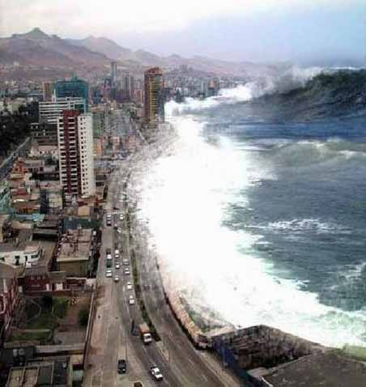
Aid Response To The Indian Ocean Tsunami
The Boxing Day tsunami occurred on 26 December 2004 after a large earthquake off the coast of Indonesia in the Indian Ocean.
The tsunami killed more than 275,000 people in 10 countries and millions of people were left homeless and without any source of food, shelter, freshwater or livelihood.
Banda Aceh on the northern tip of Sumatra,
Indonesia’s largest island, was the closest major
city to the earthquake. In Aceh:
170,000 were listed as killed
500,000 were made homeless
Bridges and roads were destroyed or made
impassable
Schools and hospitals were damaged or
destroyed
Over 1000 fishing boats were swept inland

Slide 30
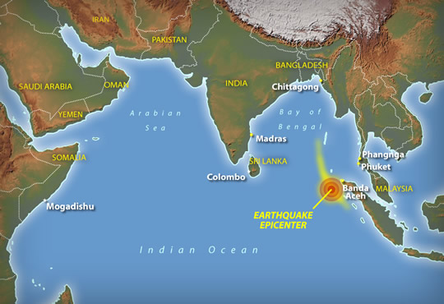
Aid response to the Indian Ocean tsunami
US$7 billion was raised for humanitarian aid, US$1.8 billion of this amount coming from personal donations
Australia’s response:
Provided clean water, medical supplies and shelter through government agencies and NGOs.
AusAID workers and Australian Police provided humanitarian aid and emergency relief.
Signed a treaty with Indonesia to provide continued support of AU$1 billion.
Internet Activity - Go to http://www.ausaid.gov.au/hottopics/topic.cfm?Id=9562_2054_7529_7688_4864
In 3-5 power point slides outline the role Australia played immediately and later in
assisting Indonesia after the Indian Ocean tsunami.

Slide 31
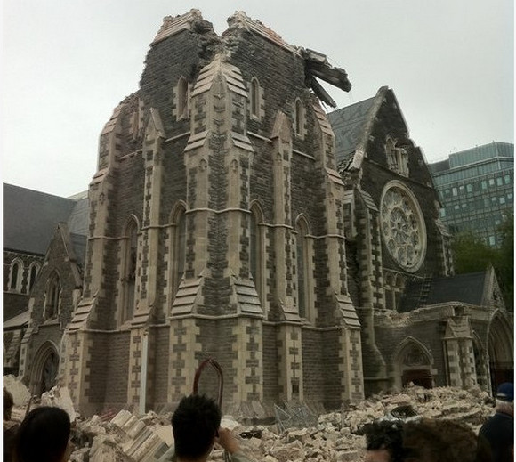
Christchurch Earthquake
As it happened
http://www.ausbt.com.au/christchurch-airport-evacuated-in-latest-new-zealand-earthquake
http://www.news.com.au/world/quake-aftershock-hits-christchurch/story-e6frfkyi-1226009960218
NGO – Red Cross
http://www.redcross.org.au/NZEQ2011.htm
Personal stories
http://www.nzherald.co.nz/natural-disasters/news/article.cfm?c_id=68&objectid=10671052
ACTIVITY – Use the above links to complete:
Imagine you are a survivor of the
Christchurch Earthquake.
Write a diary entry recalling the
events of the day of the
Earthquake (February 22 2011)
including the aid that you received.

