Slide 1
Australia
Tourism

Slide 2
Australia has developed strong global links through its tourism and sport.
Both industries are of great economic importance to Australia and are a significant source of growth for the Australian economy.
While tourism is also an important source of employment in Australia, sport is significant for its image as a national 'religion' or 'obsession' with its own potential for attracting sport and business relationships with other countries.

Slide 3
Tourism
The importance of tourism to Australia may be seen in the number of Australians travelling overseas and, in turn, the thousands of overseas tourists visiting Australia each year.
It has been Australia's single largest source of foreign exchange dollars and a significant source of employment and economic growth.

Slide 4
Sources of inbound tourists
Where do you think tourists coming to Australia are from??
_____________
_________________
_________________
_________________
_________________

Slide 5
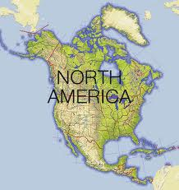
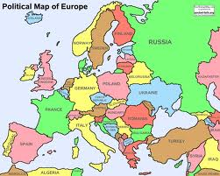
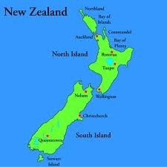
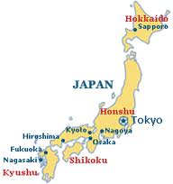
EUROPE

Slide 6
Millions of visitors have recently come to Australia, with an increase in arrivals over the previous decade.
Inbound tourism has traditionally come more from Europe and North America but the fastest growing source of tourists with significant increases has been in Asia-Pacific countries, particularly New Zealand.
Overall, the top source countries for visitor arrivals have often been New Zealand, followed by Japan, the United Kingdom and the United States.

Slide 7
Significant increases for tourists have recently occurred for China, New Zealand, and Japan.
Tourist numbers from European countries such as Italy, France and Ireland have also significantly increased.
While New Zealand has seen the most visitor arrivals to Australia, Japan has often been Australia's largest financial tourism market.

Slide 8
Outbound destinations for tourism
The number of Australians travelling overseas has steadily increased, and is currently at the highest annual number of departures so far recorded.
The most popular destinations have often been New Zealand, followed by the United States, the United Kingdom, Indonesia and Thailand.

Slide 9
http://youtu.be/3pOVfJwBd5s
What image of Australia does this ad promote?
What types of activities does it suggest you could do in Australia?
Is this an accurate depiction of life in Australia? Why, why not?

