Slide 1
Coastal management
Gold Coast

Slide 2
Located in the South-eastern corner of Queensland, the Gold Coast is one of the fastest growing regions in Australia.
It is Australia’s sixth largest city, attracting around 15,000 new residents each year.
As a tourist destination it is also one of Australia’s most popular locations, attracting on average 80,000 visitors PER DAY!!!!

Slide 3
Development issues
The sustainable use of resources is a priority today for any development planned for the Gold Coast.
This especially applies to the beaches, but it has not always been the case.
In the past, development took place with little consideration or understanding of the geographical processes that operate in the coastal environment.

Slide 4
Erosion and deposition are natural processes.
During big seas the beach and foredune are eroded away, only to be built back up again by constructive waves.
Property built on the shoreline can be at risk of destruction from storm waves.

Slide 5
During storms in 1967, 1972, 1974 and 1996, the beaches of the Gold Coast experienced severe erosion and the eroded material was not being replenished.
Some beaches even began to disappear completely.

Slide 6
1967

Slide 10
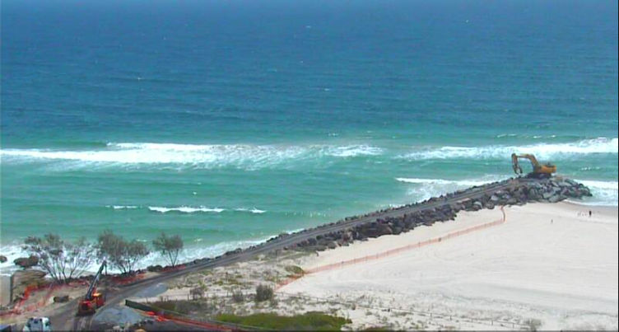
An act of Parliament enabled the construction of groynes like this one at Kirra Beach to protect property and catch sand. However, some saw it as un ugly intrusion onto the natural beach environment.

Slide 11
Management Strategies
In an attempt to manage Gold Coast beaches, the Queensland government passed the Beach Protection Act in 1968 that established the beach protection authority.
This government body has the power to implement management strategies including the building of rock walls and beach nourishment programs at strategic points along the coast.

Slide 12
As a solution to erosion of the beaches in the area and the protection of property, this authority has been successful, even creating some outstanding surfing spots such as Kirra Beach.
A criticism of their actions has been that some of the coastal management strategies they have implemented have looked unsightly and detracted from the beauty of the beach – one of the main reasons for development of the area in the first place.

Slide 13
Questions
Why is the Gold Coast regarded as an important residential and tourism region?
Identify the coastal processes that threaten the developments located along the foredunes.
Name two coastal management techniques that have been used to protect the Gold Coast beaches.
What role has the Queensland government had in managing the Gold Coast beaches? How successful have they been in managing the coastal environment?
Why have some of the management solutions applied to Gold Coast beache been criticised?

