Slide 1
Impact of human activity on coasts
Subtitle

Slide 2
Australia was settled by Europeans in 1788.
Since that time the population has remained concentrated around the coast.
This is partly because the coastal zone was the site of all early settlements.
Australia’s coastline has been an excellent site for developers as choice real estate is located within a close proximity to spectacular coastal views.

Slide 3
Many early settlements in Australia were located on estuaries, which provided ready access to safe anchorage and freshwater.
These settlements subsequently became the sites of most major cities and towns and the estuaries were developed as ports for industry and transport.

Slide 4
Write this definition down!!!

Slide 5
Eventually, the housing and the population’s various recreational activities resulted in:
land clearing
estuary reclamation
accelerated sediment run-off
pollution
the introduction of exotic plant and animal species, including marine pests.

Slide 6
Of Australia’s more than 900 larger estuaries, 17 per cent are classified as modified and 11 per cent as severely modified (as of 2001).
In addition, away from urban areas, the rich estuarine and delta floodplains have become the site of intense agriculture, particularly in Tasmania, Queensland, the north coast of New South Wales and southwest Western Australia.

Slide 8
Human modified estuaries
Estuaries around Australia have been studied and classified according to their environmental conditions, taking into account the degree to which they have been modified or the impact of changes since European settlement.
They can be loosely classified as either near pristine or heavily modified estuaries.

Slide 9
Near pristine estuaries
An estuary is classified as being near pristine if it has the following characteristics:
a high proportion of natural vegetation cover in its catchment
minimal changes to stream flow in the catchment
no intervention to the tidal system
minimal disturbance from catchment land use
minimal changes to floodplain and estuary ecology
low impact from human use of the estuary
minimal impact from pests and weeds.

Slide 10
It is important to have near pristine estuaries because they are necessary for the conservation of marine species, terrestrial communities and ecosystems.
They provide a well-preserved habitat for plants and animals and a breeding site for many migratory animals.
These environments often support fishing and recreational activities.
Near-pristine estuaries provide a standard from which all other estuaries can be graded.
Fifty per cent of Australian estuaries have been identified as being near pristine.

Slide 11
A survey by Geoscience Australia found that most of Australia’s near pristine estuaries are located in tropical northern Australia and temperate western Tasmania, away from population centres.
However, they are found also in developed areas of Australia within, or near to, National and State parks.

Slide 12
Heavily modified estuaries
To be defined as a heavily modified estuary, the system must be physically altered by human activity resulting in a substantial change in character.
The modifications are not temporary nor intermittent.
Modifications include changing the flow of the river, building of dikes, introduction of foreign plants and animals, and lowered water quality by the addition of wastes.

Slide 13
‘Sea change’ population movements
For many years beaches and dunes were considered worthless land unsuitable for agriculture or grazing because of the low fertility of the sandy soil and extensive low-lying areas prone to flooding.
Small coastal communities usually developed around estuary-based ports, which were used for shipping and transport until the 1950s.

Slide 14
Road improvements and increased vehicle ownership resulted in more people travelling to and along the coast for recreation, usually camping or staying in caravan parks.
Since the 1960s there has been a sea change shift as many people began retiring on the coast and the former coastal ports became holiday destinations.
In addition, a buoyant economy, which has driven the rapid growth of industries and services, has led to a rapid expansion of most coastal cities and regional towns.
The resulting population growth is placing huge pressure on communities, coastal resources and environmental health.

Slide 15
A major concern about this population shift is the lateral spread of communities along the coastal zone, which is known as ribbon development.
This form of development can lead to cities or towns becoming over-extended, making them difficult to manage and service, and can lead to degradation of the coastal environment.
Building on fore-dunes and headlands is risky because the beach or dunes can erode and headlands can collapse, which could inevitably ruin the coast’s visual appeal.
To avoid this situation, new developments need to be built behind the fore-dune and away from cliffs, with an additional buffer zone in case of future inundation and erosion.

Slide 17
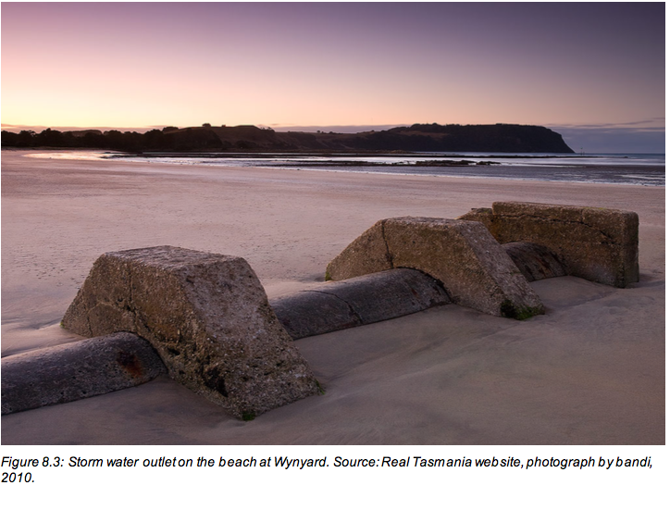
Increased discharge of contaminated stormwater, sewerage and sediment into the sea has accompanied land clearing and new development along the coastal fringe.
This problem can be mitigated by stronger management of building sites, control of stormwater by sedimentation tanks and storage, and recycling or treatment of all sewerage before it is released on the coast.

Slide 18
The introduction of exotic flora and fauna is a major concern.
In eastern Australia, the South African Bitou bush has invaded fore-dunes, while beach weeds such as sea spurge and sea wheat grass have invaded fore-dunes across southern Australia.
These weeds replace native species and have an impact on fauna.

Slide 19
One of the most noticeable impacts at the shoreline has been the construction of structures designed to manage the coast, sometimes with un-intended negative consequences.
For example, in New South Wales 22 training walls of rock were built during the 1970s at the mouth of rivers and some estuaries to improve navigation.
Some training walls, such as those at the Tweed River and Brunswick River, severely disrupted longshore sand transport.
This led to erosion down drift from the training walls on Queensland’s Gold Coast beaches north of the Tweed River and the complete erosion of the Sheltering Palms community at Brunswick.

Slide 20
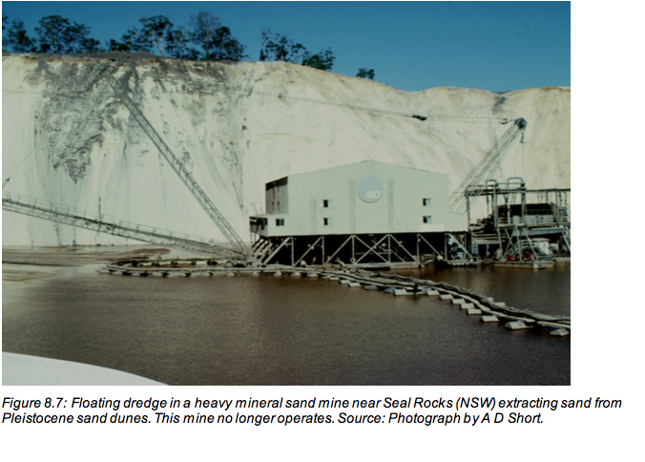
Some coastal areas have undergone development for their natural resources. Sand mining, for example, occurs along sandy coastlines to recover aggregate and minerals.
Aggregate mining of sand for the construction industry removes the sand and leaves a hole, as at Kurnell in Sydney and Beachmere in northern Moreton Bay. Mining usually occurs in the backing dunes rather than the beach.

Slide 21
Worksheet: Resort impacts

