Slide 1
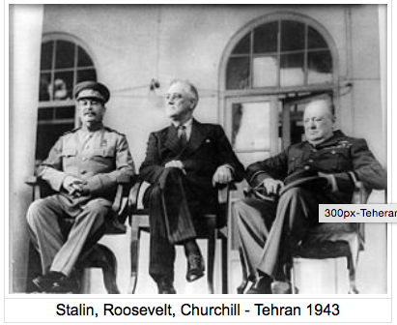
Origins of the Cold War 1945–1953

Slide 2
1945 conferences and the emergence of the superpowers
Focus questions:
Why was there underlying tension and suspicion between the USSR and the West? Refer to events between the two World Wars and during the war.
For each conference (Yalta and Potsdam), answer the following:
Where was the conference held?
When was the conference held?
Who attended the conference?
What were the issues under discussion and the decisions made at the conference?

Slide 3
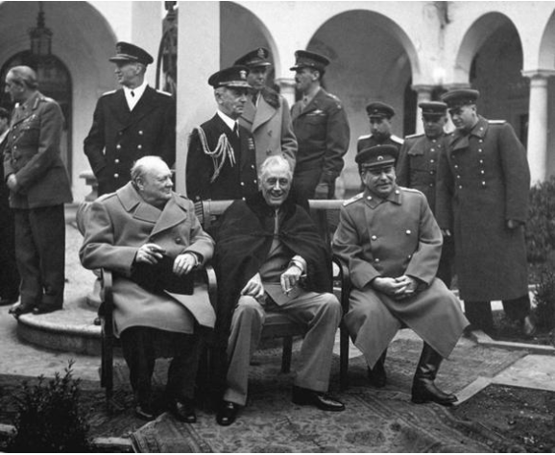
The Yalta Conference
Where: Yalta on the Crimean peninsula in the Black Sea.
When: 4-11 February 1945. Germany was nearing defeat. Japan was still in the war. Russia was in a dominant military position: she had occupied much of Eastern Europe and was nearing Berlin. The Western allies had not yet crossed the Rhine. The Atomic bomb had not yet been tested and it was not sure that it would work. Roosevelt was unwell.
Who: The leaders of the Grand Alliance: Roosevelt, Churchill, Stalin.

Slide 4
Issues: Voting procedures and membership of UN; Poland and Eastern Europe; treatment of Germany and Austria; Soviets joining the war against Japan.
Decisions:
unconditional surrender of Germany
four-power occupation of Germany and Austria
war-crimes trials
United Nations
free elections for Eastern Europe

Slide 5
Secret agreements:
USSR to enter war against Japan
USSR to gain territory in Asia from China and Japan
USSR to take land from Poland and Poland would gain land from Germany (Poland to be moved to the west)
Unresolved:
Reparations
Polish self-determination: important for Britain - this was why they declared war; vital for USSR as it was the route of invasion for Germany in WWI and WWII. A communist government had been set up in Poland in Jan. 1945. Britain supported the democratic Polish government in exile.

Slide 6
March 1945: Russia was not invited to a meeting to negotiate the surrender of German troops in Italy. Russia decided to relocate the new border between Poland and Germany further to the west. Soviet governments installed in Bulgaria and Hungary.
April 1945, Roosevelt died. Replaced by Harry S. Truman.

Slide 7
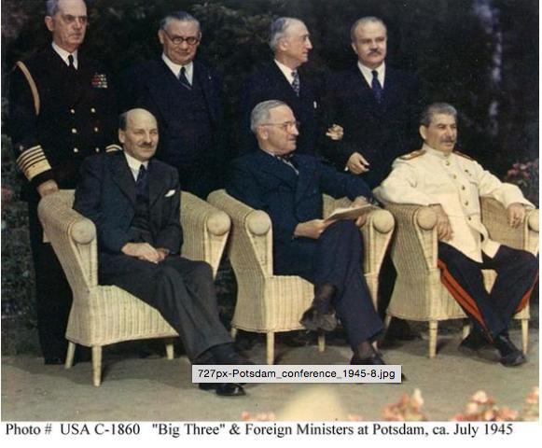
The Potsdam Conference
Where: Royal palace at Potsdam near Berlin.
When: 17 July - 2 Aug 1945. Germany had surrendered on 8 May. Japan was still in the war.
Who: Stalin, Churchill (replaced by Clement Attlee midway through the conference), Harry S. Truman.

Slide 8
Agreements:
Allied Control Council for Germany
Germany: single economic unit
No agreement:
Reparations - Soviets demanded $10 billion dollars
Border between Poland and Germany. To the Russians it was permanent.
Polish self-determination
Soviet control of the Black Sea straits.

Slide 9
Potsdam Declaration 26 July called for unconditional surrender of Japan: “The alternative... is prompt and utter destruction.” (Roosevelt had told Stalin of the Atomic Bomb on 24 July.
Potsdam Protocols signed 1 August.

