Slide 1
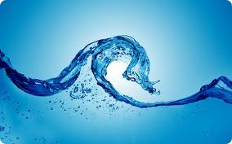
Precious water

Slide 2
The World
● Three quarters of the Earth’s surface is covered with water.
● 97 per cent of this water can’t be used by people, plants or animals, because it is found in the oceans as salt water.
● The other 3 per cent is fresh water. Of this 2 per cent is frozen in ice caps, glaciers and on snowy mountain ranges.

Slide 3
● Only about 0.5 per cent of the remaining water on earth is useable, fresh water.
● 80 per cent of the water we use is surface water.
● 30 to 50 times more water is found underground. Ground water is the water found between particles of soil and rocks beneath the ground.

Slide 4
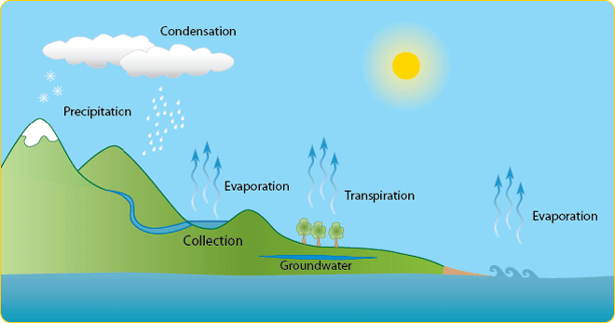
The Water Cycle

Slide 5
Australia
● In the last 100 years there have been 37 years of major drought conditions in NSW.
● Different States and Territories use different amounts of water, the hottest states use the most water.

Slide 6
Sydney
● The water we use inside our homes each day in the Sydney catchment area would fill 450 Olympic swimming pools.
● The water we use outside our homes each day in the Sydney catchment area would fill 150 Olympic swimming pools.

Slide 7
People
● Water makes up two-thirds of your body.
● People drink six to eight cups of water, milk,
fruit juice, soft drink, tea or coffee a day.
● Plants and animals are mostly water too.

Slide 8
● People use water for drinking, cleaning, growing and processing food, growing crops, leisure activities, cooking, putting out fires and
generating electricity.
● The average daily water use per Australian is
about 500 litres.

Slide 9
● 20 per cent of the water used in the home is for showering/bathing.
● 25 per cent of water is used outdoors when watering gardens.
● 23 per cent is used when flushing the toilet.

